Slide 1

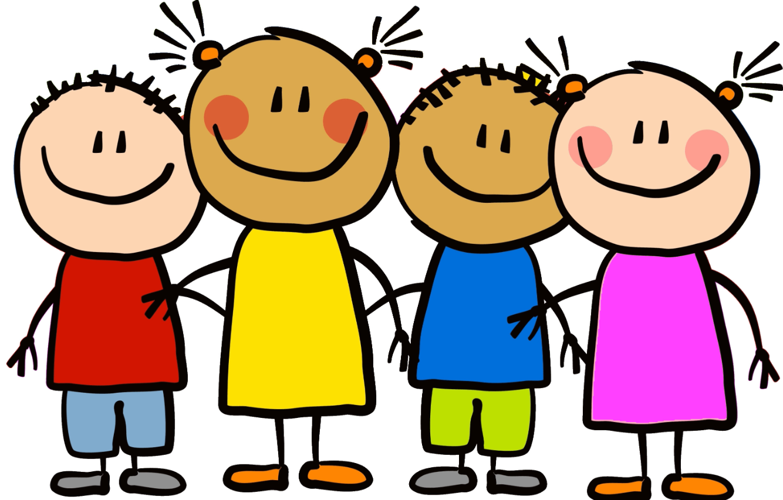
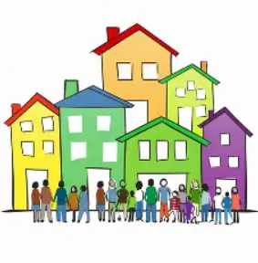
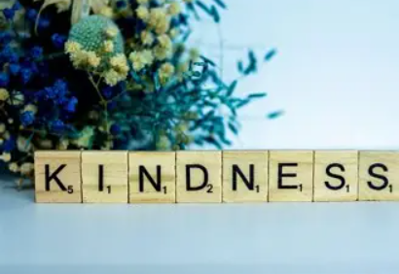

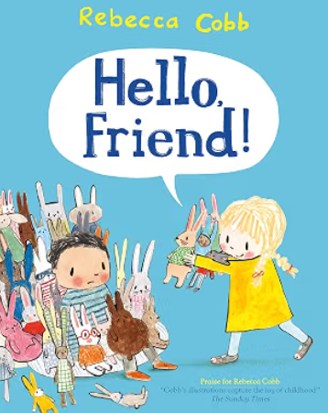

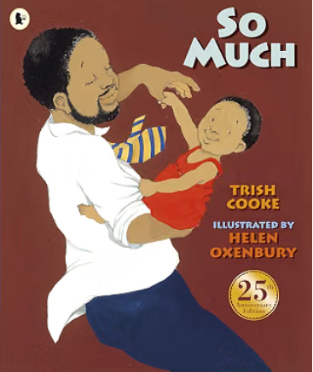
Pippins Class Term: Autumn Topic: Marvellous Me
Our Big Questions
What makes me, me?
Where do I belong?
Sticky Vocabulary – these are the words we will remember
Appearance
Different
Similar
Describe
Feelings
Voting
Understand
Belonging
Unique
Community
Respect
What will we be exploring? | Some things to think about….
Similarities and differences | What do I look like? What do my friends look like? Who is in my family? What do I like and dislike? Do we all like the same things?
Belonging | What does the word community mean? What communities or groups do I belong to? How does being part of a group or community make me feel?
Friendship and kindness | Who are my friends? What do I like about my friends? How do I treat my friends? How do we show kindness to other people? How do we show kindness to ourselves.
Spirituality
Children will be encouraged to explore what makes each person unique and special, noticing the similarities and differences between themselves and others. They will reflect on what it means to belong to a family, friendship group, class and wider community, and how this can help us feel valued, loved and accepted. Through exploring friendship and kindness, children will consider how we can care for others, celebrate differences and show kindness. We will nurture a sense of wonder, belonging, self-worth and respect, helping children to recognise the marvellous qualities in themselves and in those around them.
Key Texts:

Slide 2


Term: Autumn 1
We will be focussing on:
Graphemes:
s, a, t, p, i, n, m, d, g, o, c, k, ck, e, u, r, h, b, f, l
Tricky Words:
Is, I, the
Key Vocabulary
Phonemes – the different sounds in a word
Graphemes – letters that represent the phonemes
Digraph – two graphemes which make one sound
Segmenting – breaking words up into the individual phonemes
Blending – putting individual phonemes together to identify a word
Tricky Words – words which need to be learnt by sight
We will be focussing on:
Match, Sort and Compare – matching, sorting and comparing objects by appearance, size and quantity,
Talk about measure and pattern – comparing objects by size, mass and capacity, and creating, continuing and correcting simple patterns.
It’s me, 1, 2, 3 – Finding, subitising, and representing 1, 2, 3, and exploring 1 more, 1 less and the composition of 3.
Key Vocabulary
Mass – how much something weighs
Capacity – how much something can hold
Subitising – being able to instantly see how many of something there is, without needing to count them individually
Composition – the different ways of making a number

