Slide 1

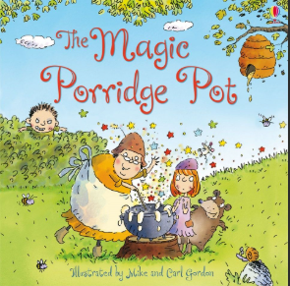
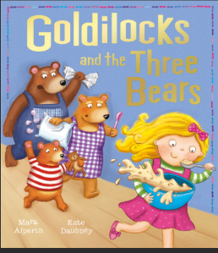
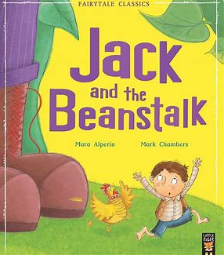
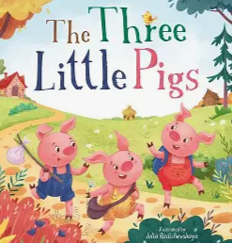
Year Group Reception Term Spring Topic: Once upon a time
Key Vocabulary
1 | Traditional Tale | A story that has been retold over many years. Sometimes called a fairy tale
2 | Setting | Where a story takes place.
3 | Character | A person or animal in a story.
4 | Hero | The main character in a story. A hero is usually a character who is good and well-liked
5 | Villain/wicked | The character who is the opposite of the hero. The villain could be mean, nasty or evil! /Someone or something that is bad.
6 | Plot | This the word we use to describe the events that make up a story, or the main part of the story. The events relate to each other in a pattern or sequence.
7 | Once upon a time | Story starter
8 | They lived happily ever after | Story ending
Sticky Knowledge
1 | Traditional tales were told rather than read as they are now. (Over 200 years ago in Germany, the Brothers Grimm wrote down the very first traditional tales. They heard them from storytellers all over Europe.) Sometimes these stories have changed over time
2 | Story structure. Stories have a beginning middle and end.
3 | Vocabulary used for the beginning and ending of the story
 | Spirituality Statement
 | Through stories, fairy tales and imaginative play, children are encouraged to wonder about the world around them. They explore ideas of good and bad, kindness and courage, and learn that their actions affect others. By sharing stories and talking about feelings, children develop a sense of belonging, empathy and respect, helping them to understand themselves, others and the wider world.
Key Questions
1 | Can you retell any traditional tale?
2 | Why are there so many animals in traditional tales?
3 | Why were traditional tales told rather than read in days gone by?
4 | Can you describe a character and explain your thoughts?
5 | What part of the story did you enjoy the most? Why?
Key Texts

