Slide 1
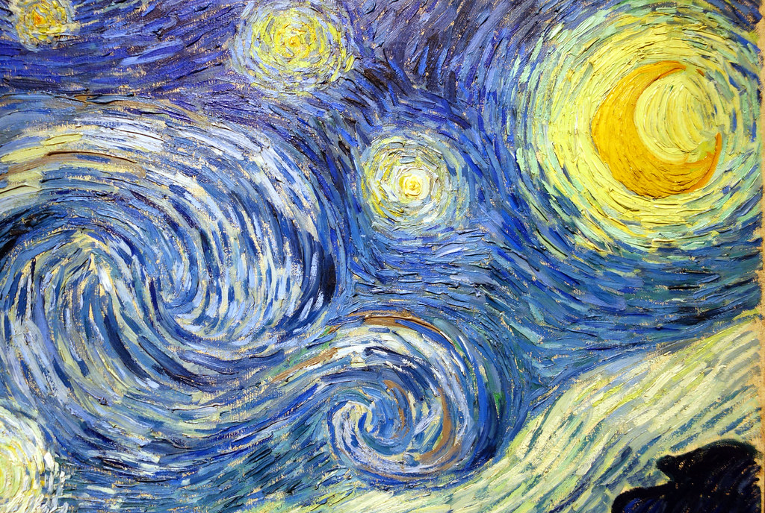
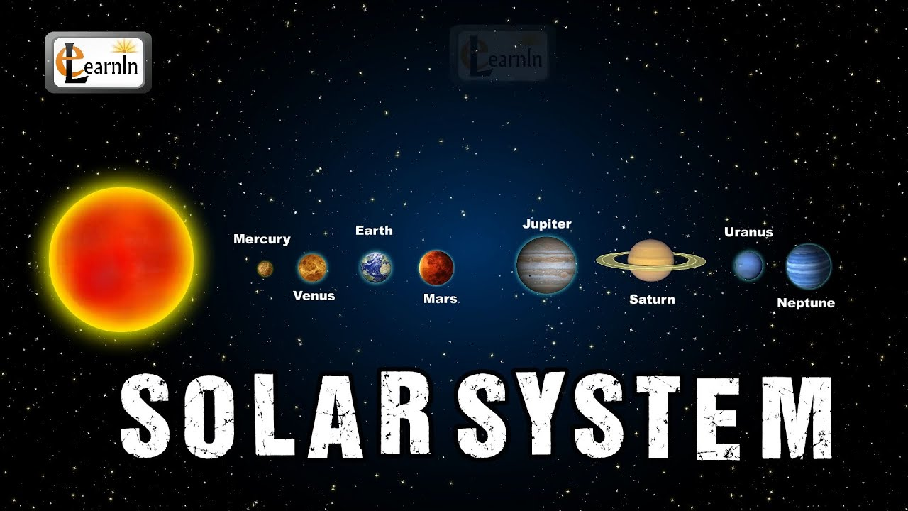
Year Group- Reception Term- Summer Topic: ‘Starry Night’
Key VocabularyI
1 | Solar system
2 | Planet
3 | Earth | Land & water
4 | Sun & Moon |  | Gravity
5 | Star
6 | Names of planets | Earth Mercury Venus Mars Jupiter Saturn Uranus Neptune
7 | Rocket | vehicle powered by a rocket engine
8 | Astronaut/space suit
9 | Alien
10 | International space station
11 | Day/Night Nocturnal | At night it is dark/in the day it is light. Some animals are awake at night and sleep during the day.
Sticky Knowledge
1 | Our planet is called Earth
2 | Earth is made up of water and land
3 | There are 8 planets in our Solar system and they orbit the sun
4 | The moon orbits Earth- it is made of rock
5 | The sun is a giant star
6 | People have travelled in space- what do they need to be able to do this
7 | Famous people – Neil Armstrong/Tim Peake | Vincent Van goph was a famous painter who came from the Netherlands. Two of his famous paintings are Starry night and Sunflowers. He became famous after his death.
Key Questions
1 | Why is the sun important?
2 | How do people get into space?
3 | What is in our solar system?
4 | What are the names of the planets? Do I know any facts about the different planets? Are they all the same?
5 | Why does day and night happen?
6 | What would it be like to live on a Space station? What would I like? Dislike?
This Photo by Unknown Author is licensed under CC BY-SA-NC
This Photo by Unknown Author is licensed under CC BY

