Slide 1
Welcome to
New Parents’ Curriculum Meeting
June 2024

Slide 2
What is the Early Years Foundation Stage?
The Early Years Foundation Stage (E.Y.F.S.) is the stage of education for children from birth to the end of the Reception year.
It is based on the recognition that children learn best through play and active learning.
It has a strong emphasis on your role as parents in helping your child develop.
We work from a Statutory Framework - the latest version is September 2021
This is a very important stage preparing them for their future learning and successes. Their early years experience should be happy, active, exciting, fun and secure; supporting their development, care and learning needs.

Slide 3
Communication and Language
The children will be learning to:
Speak- talk confidently and clearly
showing awareness of listener RESPECT. Holding a conversation with an adult or peer.
Listen- enjoy listening to stories, songs and poems, showing good attention. Developing a rich range of vocabulary.
Understand- follow instructions, answer questions about stories

Slide 4
Personal, Social and Emotional Development
The children will be working on:
Self Regulation-
Show an understanding of their own feelings and those of others,and begin to regulate their behaviour accordingly. Wait for what they want!
Manage self- following rules! (Golden Rules)
Be confident to try new activities and show independence, resilience and perseverance in the face of challenge. Looking after their bodies and needs. Changing independently…CLOTHES NAMED PLEASE (key rings/ colourful ribbon on PE bags please) No rucksacks please.
Building relationships- developing good friendships. Work and play cooperatively and take turns with others
School PSHE Scheme is called Jigsaw- Themes are changed half termly.

Slide 5
Physical Development (Gross and fine motor control)
The children will be learning to:
move confidently and energetically/develop spatial awareness; Autumn Term – Dance/ Spring –Gymnastics/ Summer - Games
control their body;
handle equipment and resources proficiently e.g. small world activities, puzzles, art & craft;
Tripod grip with pencil
Use scissors- please practice at home

Slide 6
Literacy
Reading
Develop a love of reading. Develop language comprehension as well as word reading
Talking about what they have read with an adult (stories/ non-fiction/rhymes/songs/poems). Use the vocabulary introduced and deepen it further.
Reading Framework 2022/Little Wandle
Reading books- will be sent home twice a week – to begin with there will be no words!
Phonic evening date to follow Autumn 2024
Notes:
Say about reading books

Slide 7

Writing
Spelling, handwriting and composition
Use phonic knowledge to spell words
Write a simple sentence that can be read by others
Hold a pencil correctly and form recognisable letters
Little Wandle scheme
Notes:
Explain about the first sounds they will be learning
Lower case letters

Slide 8
Mathematics
The children will be learning to:
Count and understand numbers to 10 (count up to 20), the relationships between them (number bonds) and the patterns within them (compare quantities/double facts/ odds and evens/sharing)
Build on their understanding using manipulatives - 5 frame/ 10 frame
Develop knowledge and vocabulary to develop mastery
Shape space and measure and spatial reasoning
Look for patterns and connections
Develop a positive attitude and interest in maths,
‘have a go’, not to be afraid to make a mistake.

Slide 9
Understanding the World
Children will learn to make sense of the physical world and their community
Talk about children’s personal experiences. Look at similarities and differences.
Listen to stories and non-fiction books to support their understanding of our culturally, socially, technologically and ecologically diverse world
Enrich vocabulary to support understanding
Forest School - observations of the
natural world around them

Slide 10
Expressive Arts and Design
Children will explore and play with a wide range of media and materials
Respond to what they hear and observe through music/ movement to music / art
Share what they have created (perform songs, poems
and rhymes

Slide 11
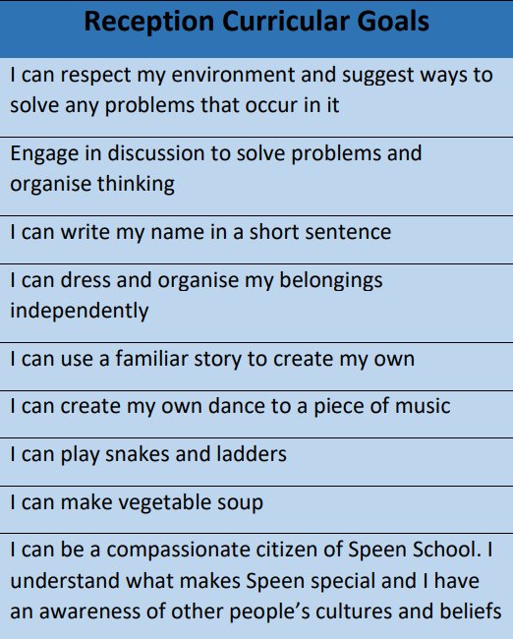

Slide 12

Timetable and Organisation
The school day – 8.30 -3.15 School lunch – all details will come from Mrs Moore
Tapestry – two way dialogue please
share wow moments from home / experiences /
‘like’ uploads please!
Show and Tell – Thursday
Teacher availability-communication -verbal pick up and drop off/email teacher through office/Monday reminders from Mrs Moore
School Website https://www.speenschool.com/

Slide 13
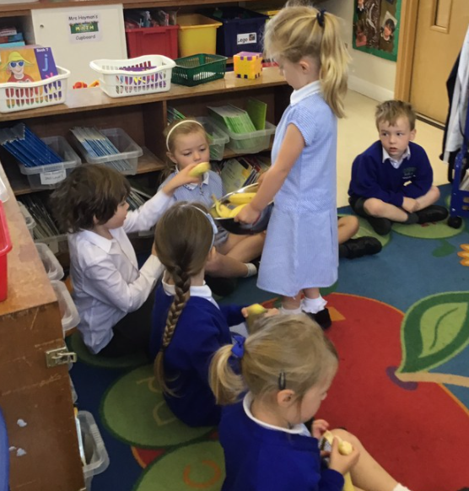
Snack Time
Milk can be ordered from
Mrs Moore
A different type of fruit is
offered daily
Named water bottle- no
Squash please

Slide 14
PE and Forest Schools
PE is every Tuesday and Forest Schools is every Wednesday.
Named wellington boots to stay in school.
Forest school waterproofs are provided.
Please bring a PE kit to school that will stay here for the half term.
Please name every item.
Reception get changed for PE at school.

Slide 15
Reading Books
Speen School follows the Little Wandle Phonics Scheme, books will be related to this.
Two reading books come home weekly, please return the following Tuesday.
They are kept in plastic wallets that come home in books bags.

Slide 16
Reward System
Rainbow Pieces- glass pebbles that they are awarded for varied WOW moments. These may be kept at home once given.
Star of the Week- 1 person chosen weekly
Head Teacher Award- for amazing work or behaviour

