Slide 1
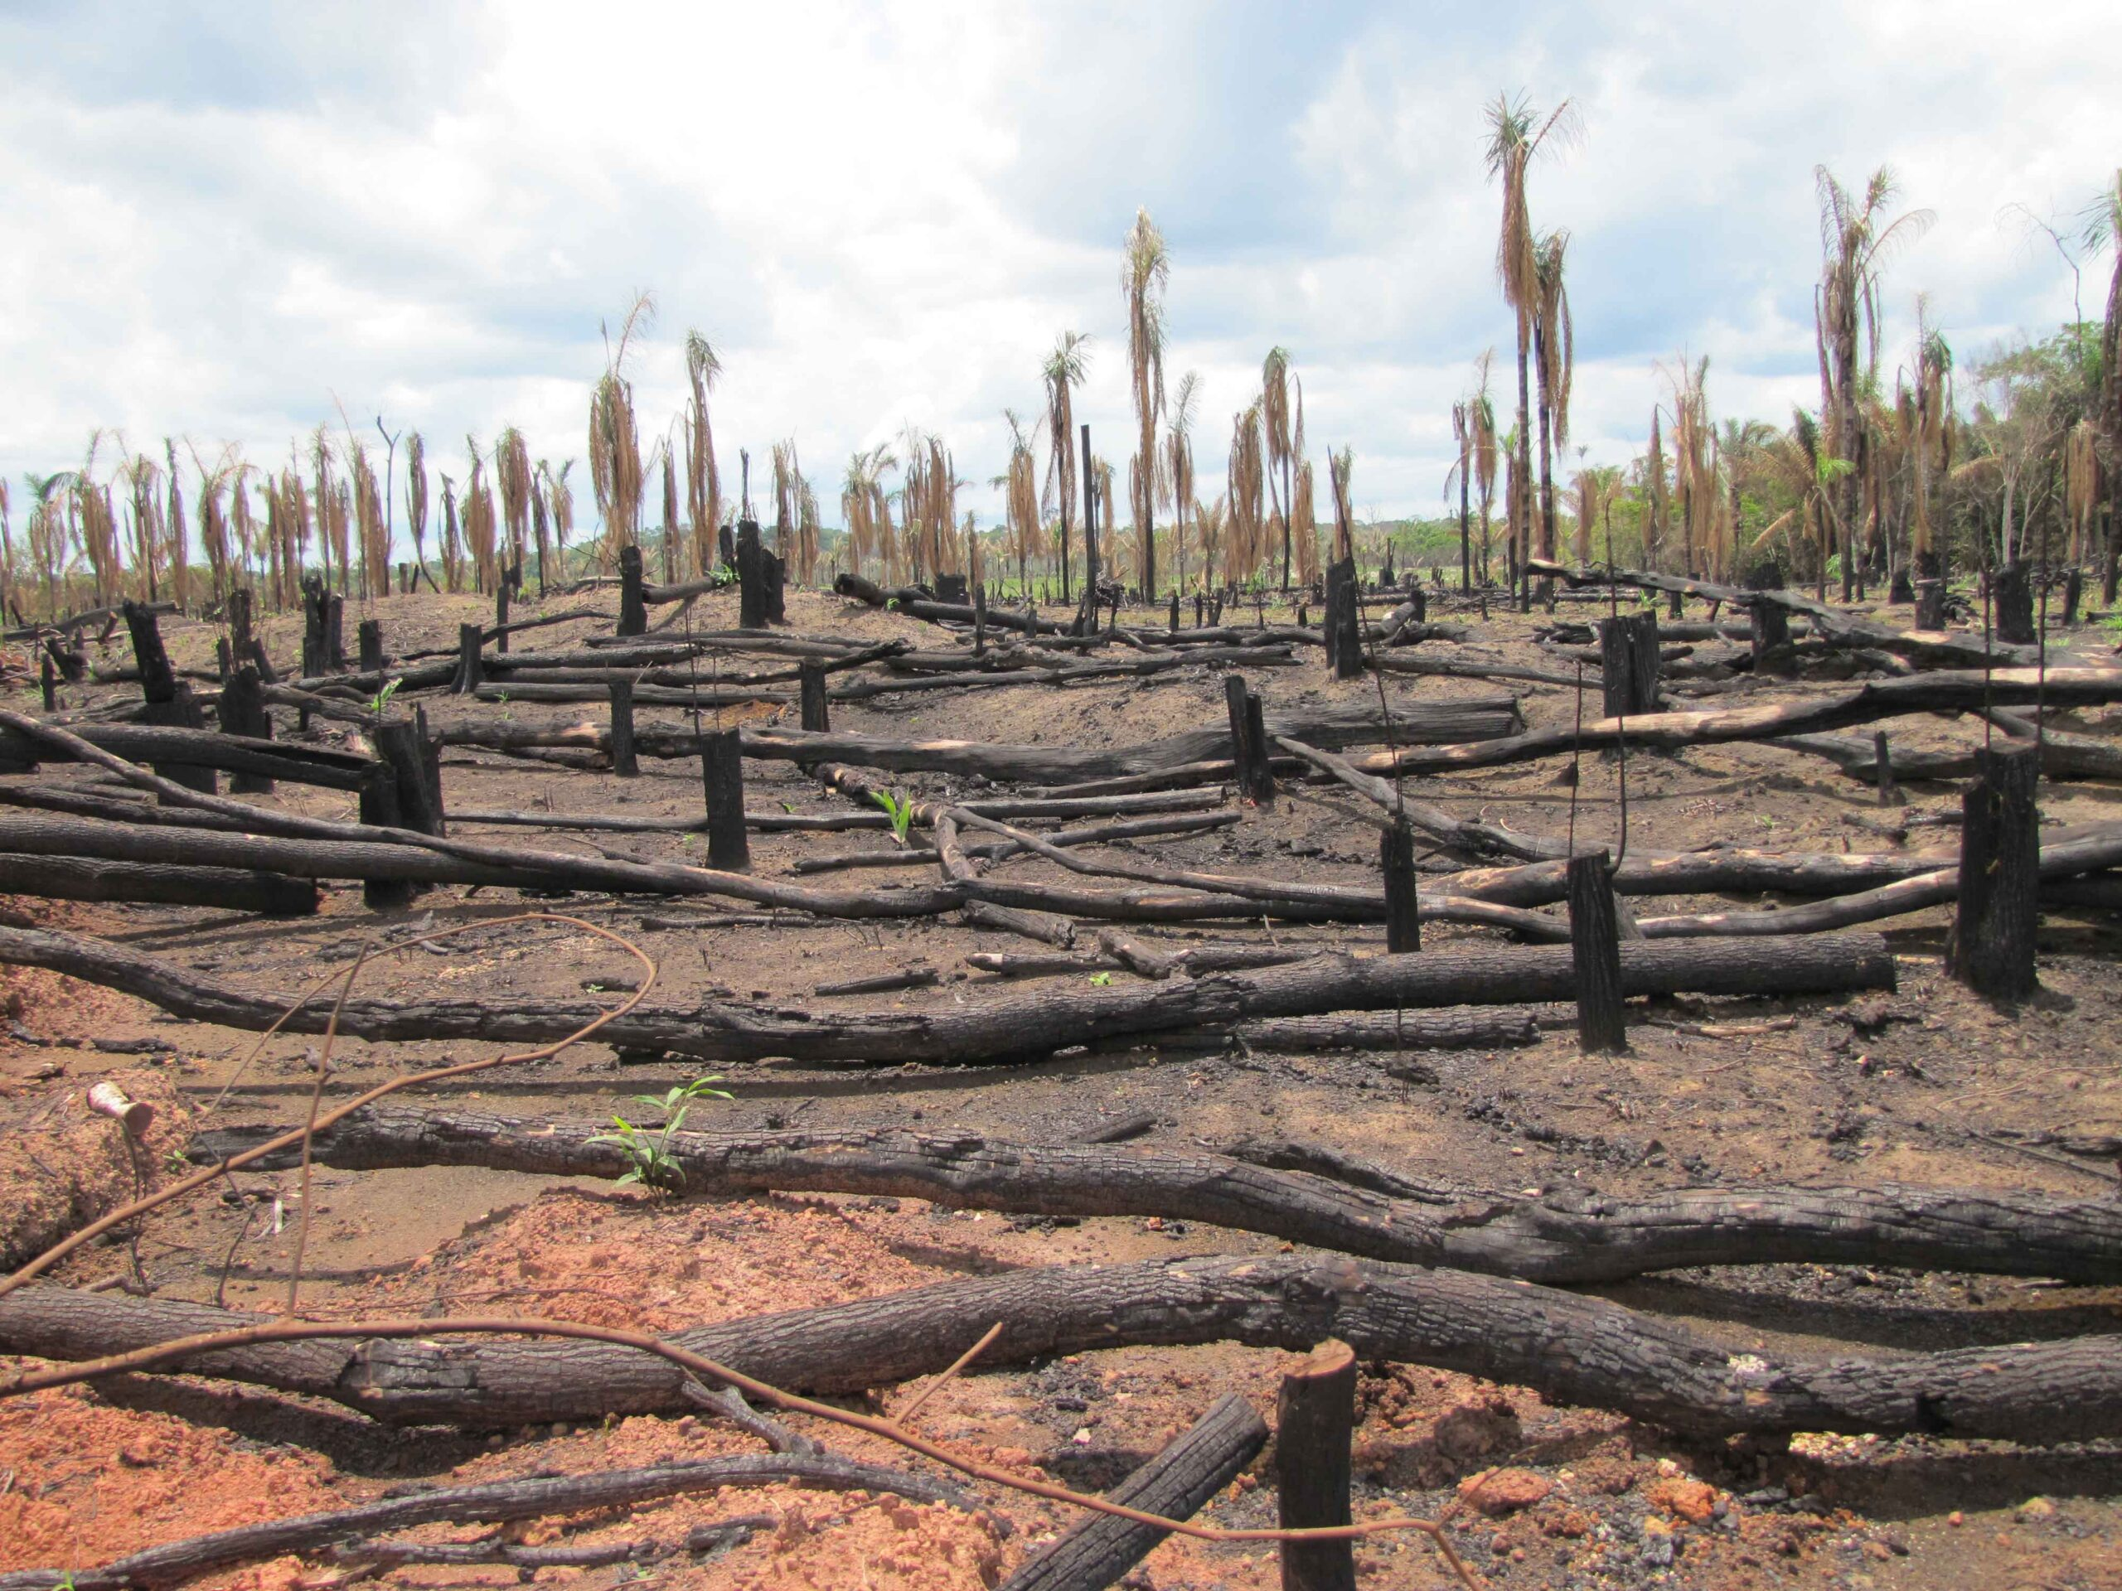
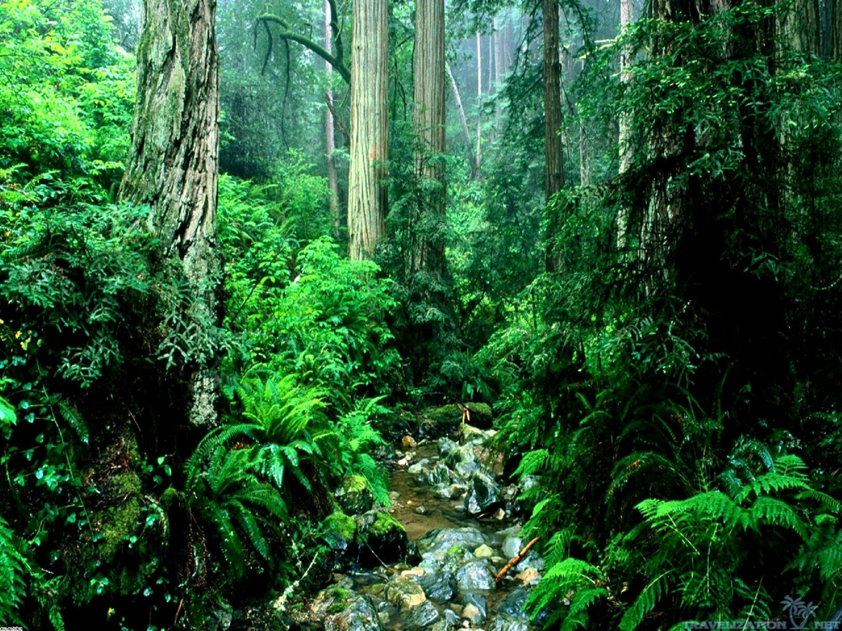
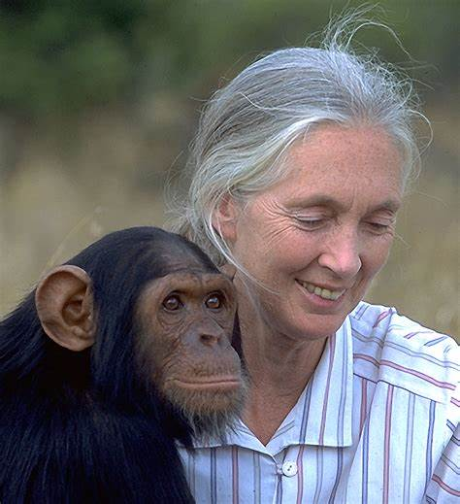
Year Group 1 and 2 Term 5 Jane Goodall and Food Technology
Key Vocabulary
1 | Rainforest | A large area of land with lots of tall trees and plenty of rainfall.
2 | Ethologist | A scientist studying animal behaviour
3 | Primatologist | A scientist studying primates.
4 | Deforestation | The cutting down and clearing of forests.
5 | Logging | Cutting down trees to create land
6 | Conservation | Protecting species from extinction.
7 | Extinction | Death of the last living species of a plant / animal.
8 | Species | A group of similar animals or plants
9 | Ingredients | The foods you need to make something
10 | Recipe | Instructions for making food
11 | Assemble | Put something together
Sticky Knowledge
1 | Jane Goodall is a primatologist and ethologist..
2 | Jane Goodall has made many discoveries about chimpanzees.
3 | Jane Goodall is the world‘s best expert on chimpanzees.
4 | Rainforests are home to more than the half of all the animal and plant species of the world.
5 | Deforestation is a threat to our planet.
5 | Conservation of animals and habitats is essential for the future of our planet.
6 | Everyone has to play a part in protecting our planet – reduce, reuse and recycle.
Key Questions
1 | What are the key events in environemtal history?
2 | Who is Jane Goodall?
3 | What are Jane Goodall‘s important achievements and discoveries? Why is she a significant person in history?
4 | What is deforestation? What can we do to protect our planet/ environment?
5 | What is animal conservation and why is it important?
6 | How can we keep ourselves safe in the kitchen? What are safe chopping skills?
7 | How do you follow a recipe?
8 | What ingredients can you combine to create a savory tart?

Slide 2
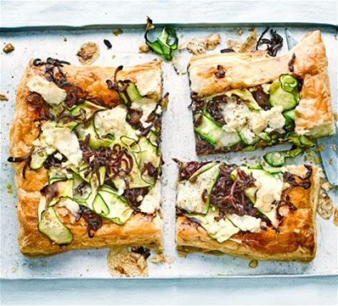
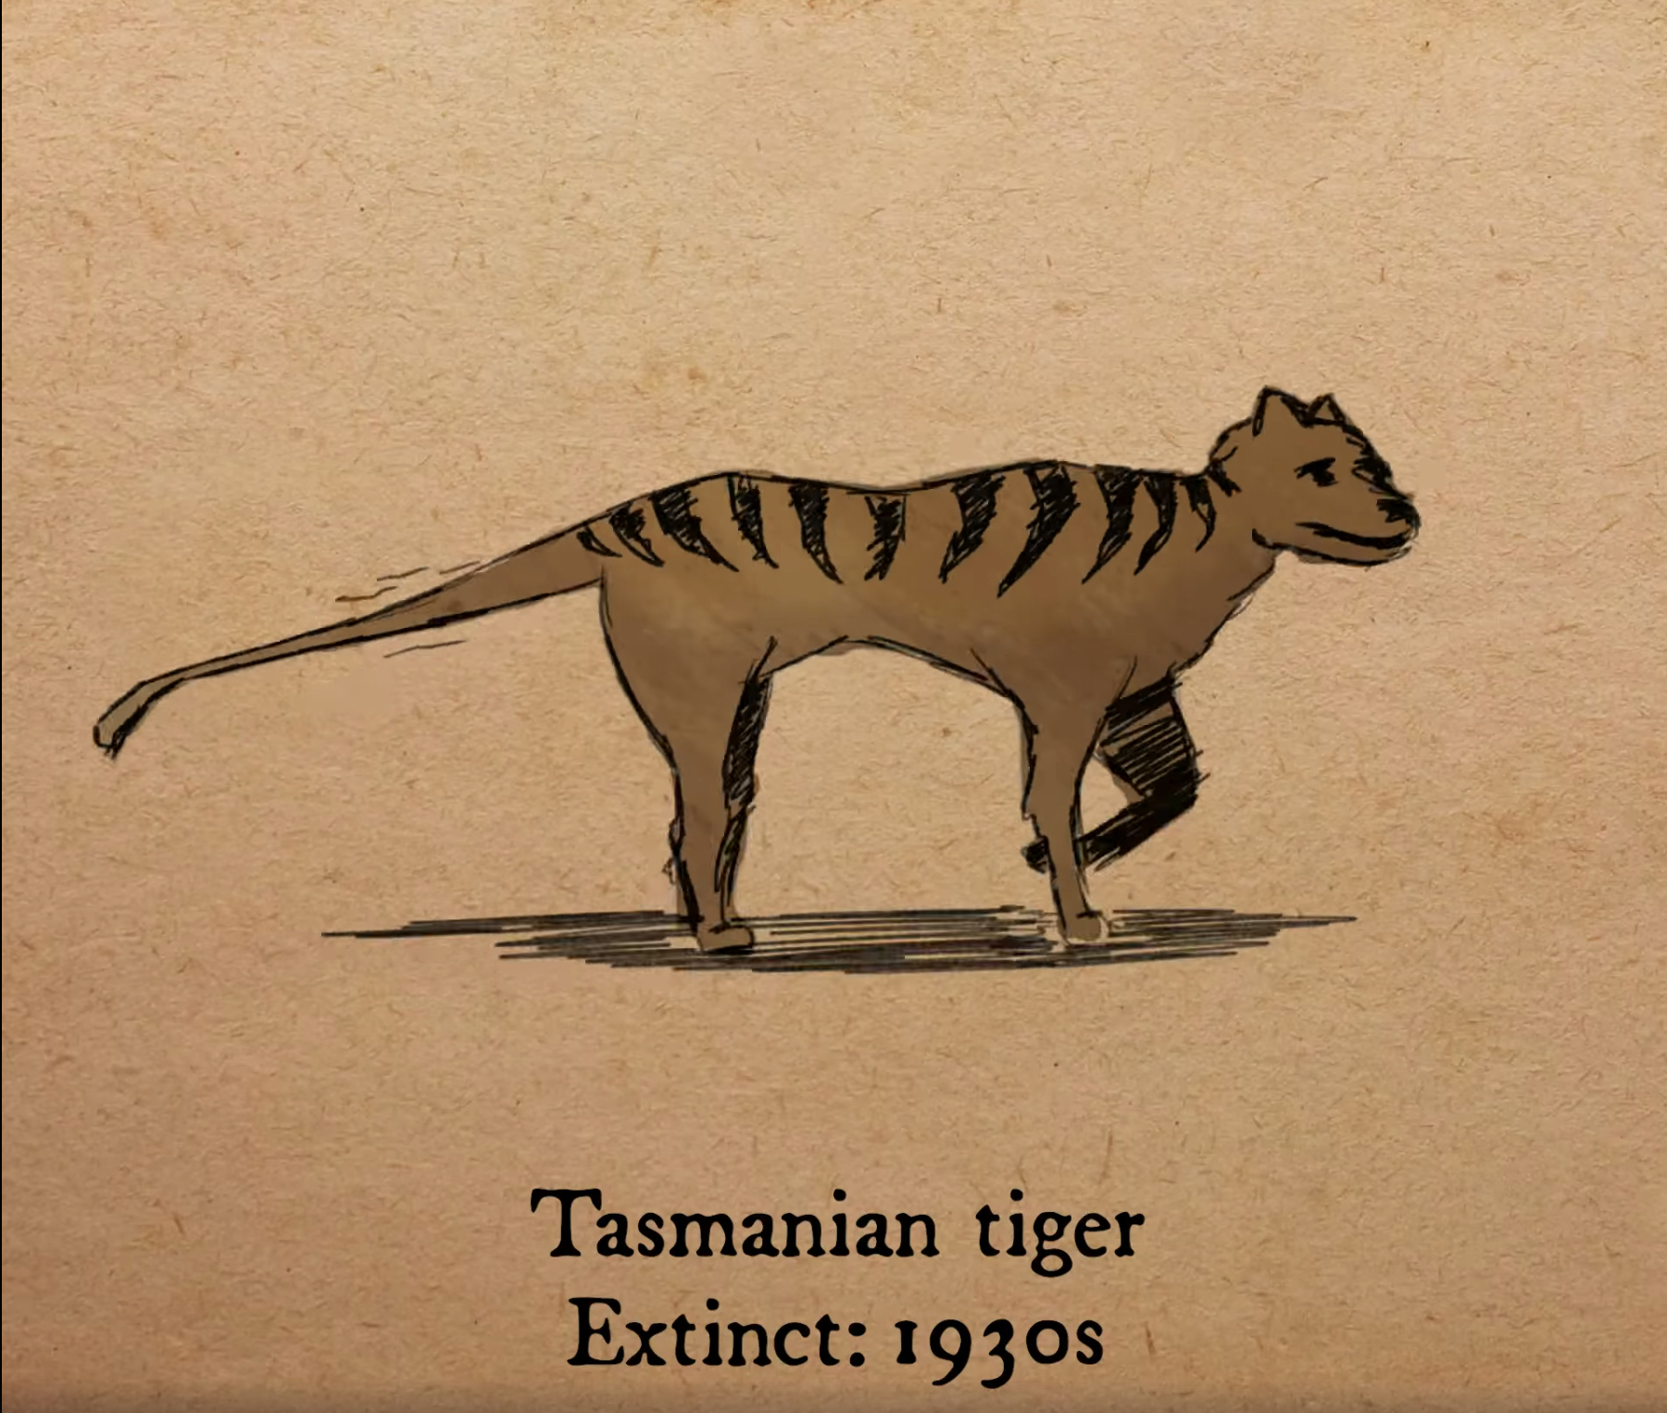
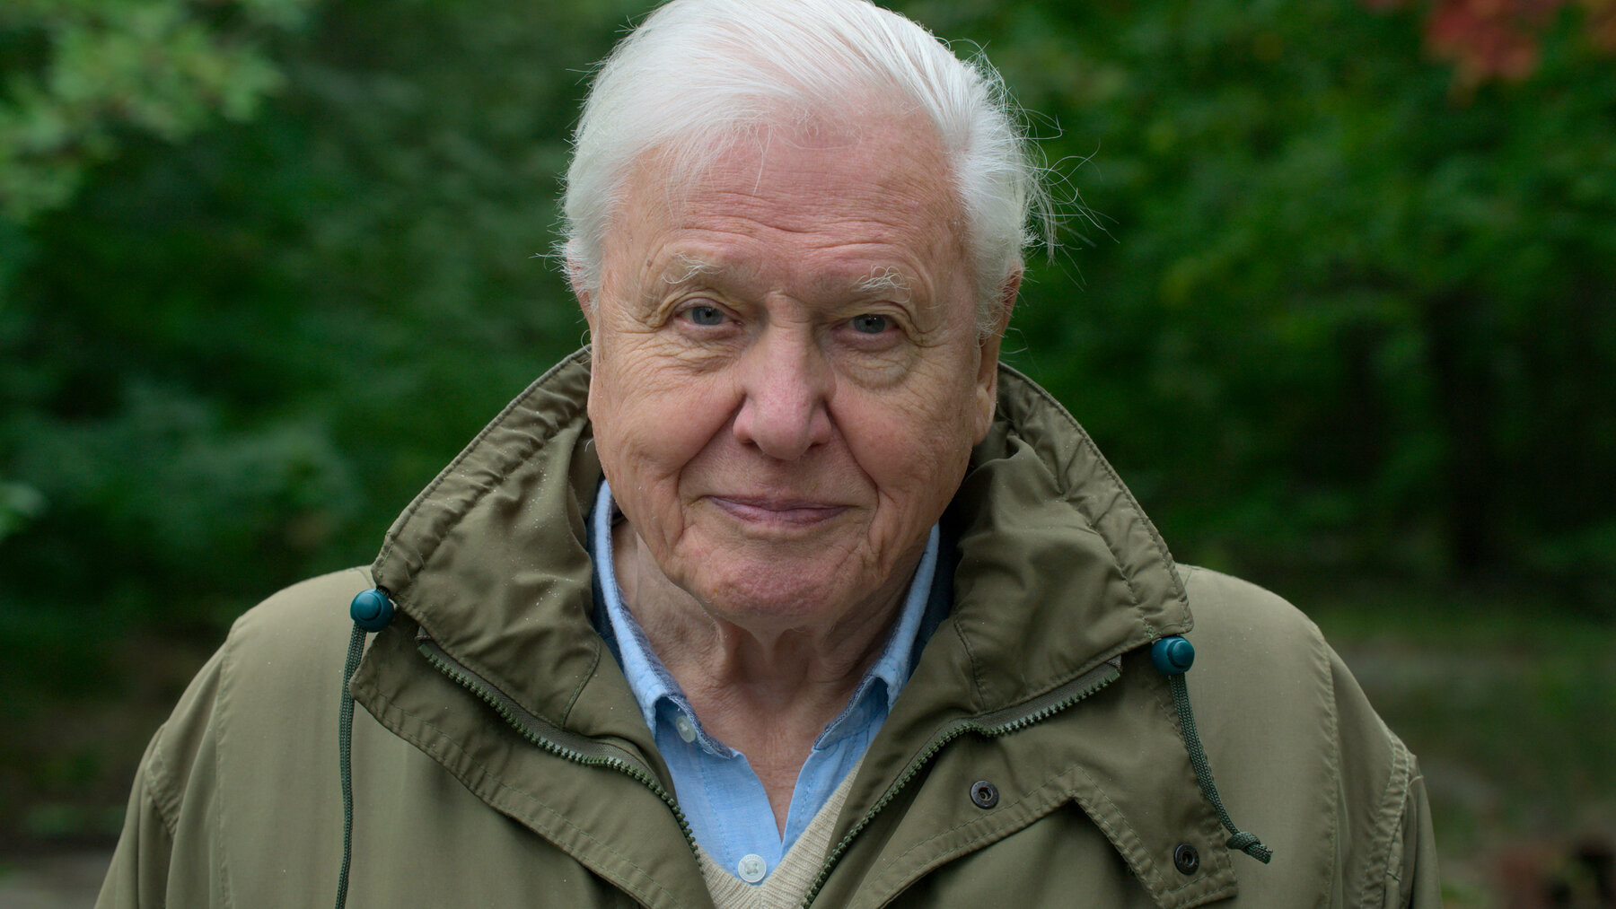
Year Group 1 and 2 Term 5 Jane Goodall and Food Technology
Prior Vocabulary
1 | Map key | Map keys are symbols to show key information on maps.
2 | Country | A country is nation with its own government, occupying a particular territory.
3 | Continent | Large continuous masses of land.
4 | Scientist | A person who researches to advance knowledge in a field.
5 | Forest | A land dominated by trees.
Prior Knowledge
Where I live might look similar or different to where others live.
An environment is what makes up a particular area. The environment can be changed by human activity.
England is the country I live in.
I know some of the continents of the world.
I know that waste can be recycled.
Future Learning – KS2 Outcomes
1 | Rainforest layers and different plants and animal species living in each layer.
2 | Locating rainforests on continents and naming countries where rainforests are found.
3 | Understanding the climate of rainforests.
4 | Deforestation and its impact: both positive and negative.

