Slide 1
Year Group 1 and 2 Term 3 Topic: Mary Seacole and Stable Structures
Key Vocabulary
Bankrupt | Run out of money
Dressing | Bandages
Fund-raising | People giving money to help a good cause
Medicine | Something that helps you get better
Prejudice | Treating people differently, normally not very nicely, because of the colour of their skin
Rejected | Not wanted
Structure | Something that is made for a purpose and holds its shape
Reinforce | To make something stronger
Appearance | What something looks like
Texture | What something feels like
Free- standing | An object standing up by itself
Joining technique | ways to join two things together so they stay connected
Sticky Knowledge
Mary Seacole was born in 1805 in Jamaica to a Jamaican mother and a Scottish father.
She learnt traditional Jamaican remedies from her mother who had a lodgings for injured soldiers.
She paid her own way to help soldiers in the Crimean War.
Mary worked on the battlefield to look after the soldiers and also set up the British Hotel (a hospital) for soldiers.
Mary was only recently recognised for her work during the Crimean War.
Structures can be shell and frame structures.
Structures can be reinforced in different ways e.g. triangulation, bracing.
There are different ways we can join parts of s structure.
Examples of Greater Depth Understanding
Children may be able to show a deeper understanding of the Crimean War e.g. recall dates and reasons and participants of the war.
Children may show a deeper understanding of what hospitals were like during the Crimean War and can compare the conditions to conditions in hospitals now.
Children can reason and gather evidence from primary and secondary sources and support their thinking with these.
Children have some understanding of the challenges that Mary would have faced being mixed race during the Victorian era.
Key Quetions
How can we work out why Mary Seacole is famous?
What were the most important events in Mary’s life?
What was Mary’s greatest achievement and how do we know?
How did life change for Mary after the Crimean war?
Why does Mary deserve her statue at St. Thomas’ hospital?
What are playground structures like?
What materials, joining and reinforcing should we use in a playground structure?
Can we plan, create and test a stable, free-standing and appealing playground structure?
How can we improve our designs?
Spirituality
Window Moments Reflecting on why individuals might dedicate their lives to help others.
Mirror Moments Considering and celebrating the people who help us / dedicate their lives to us.
Door Moments Choosing a person we can help ourselves in a practical way.

Slide 2
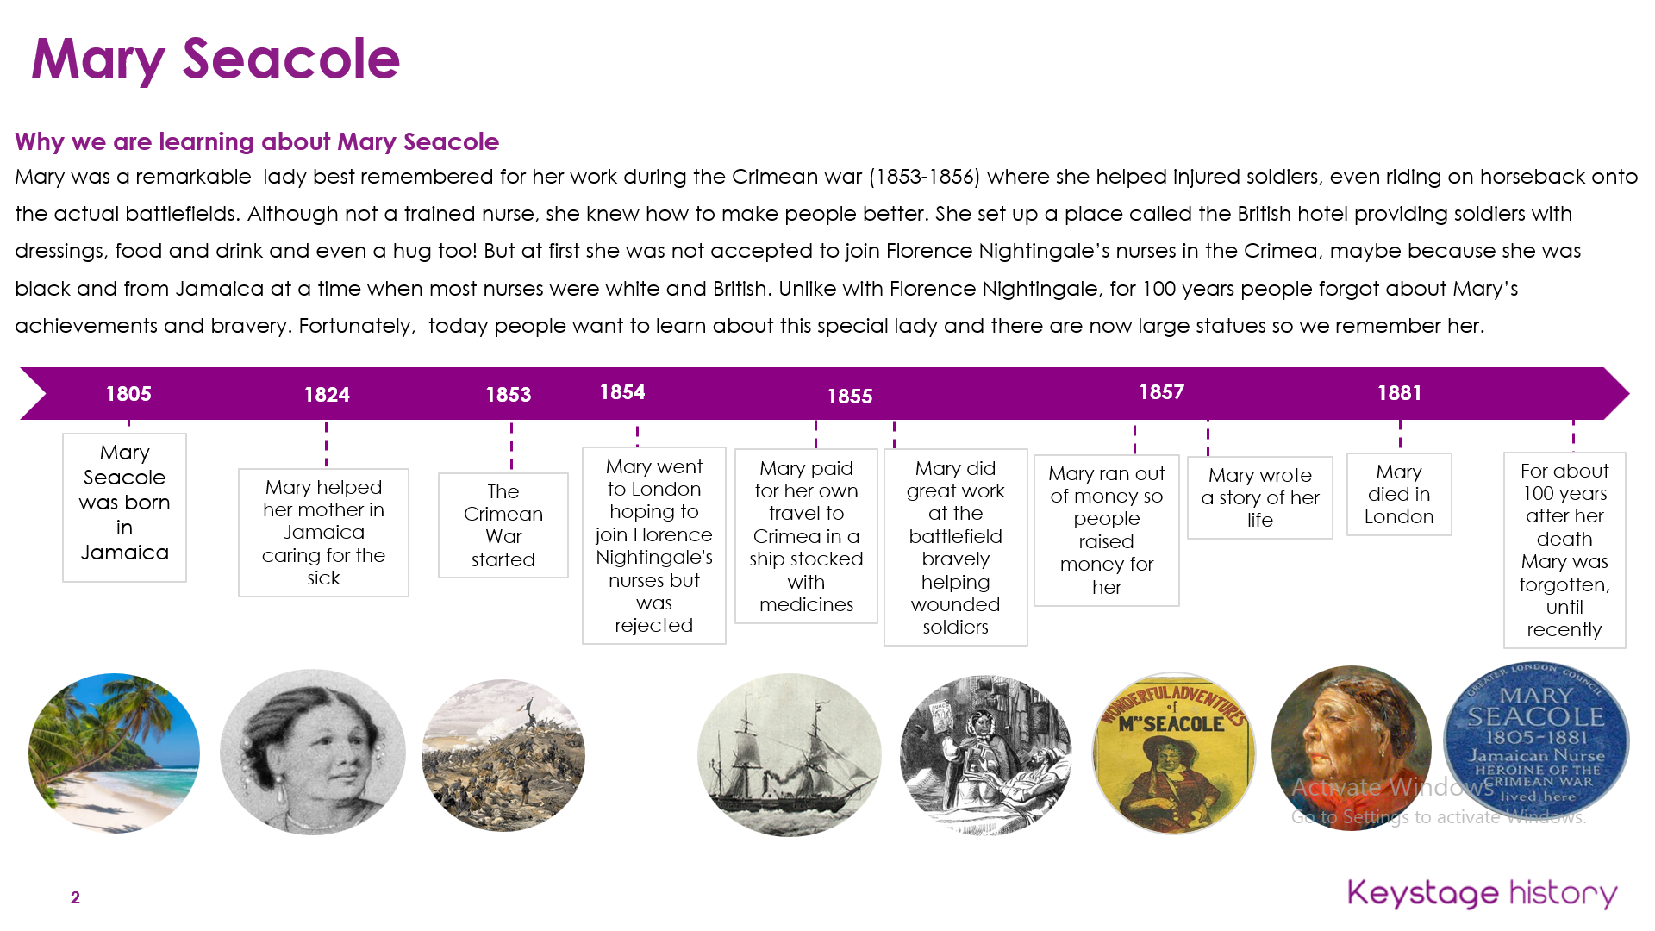
Year Group 1 and 2 Term 3 Topic: Mary Seacole and Stable Structures
Prior Vocabulary
History | The study of what has happened in the past
Past | What had already taken place
Present | What is happening now
Time line | A visual representation of the passing of time
Significant individual | An individual who had important achievements.
Achievement | To reach an important goal
Prior Knowledge
Children have talked about past and present events in their lives and in the lives of family members.
Children understand that things change over time e.g. toys are different now to what they were like within living memory.
Children can use words and phrases: old, new, now, then, yesterday, living memory .
Children can sequence events or items in chronological order.
Children have learnt about significant individuals from history as well as other walks of life e.g. Brother Grim, David Attenborough, Jane Goodall, Vincent Van Gogh.
Future Learning – KS2 Outcomes
A study of an aspect or theme in British history that extends pupils’ chronological knowledge beyond 1066 e.g. a significant turning point in British history, for example, the first railways (including significant individuals)

