Slide 1
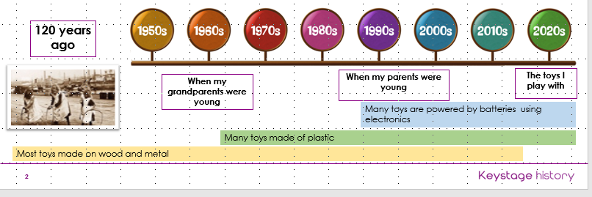
Year Group 1 and 2 Term 1 Topic: Toys from the Past and Puppets
Key Vocabulary
Timeline | A visual representation of the passing of time
Modern | Present time or recent
Materials | What things are made of
Plastic | Type of manmade material that is made by machine and can be moulded into any shape or colour
Wood | Type of natural material
Metal | Type of natural material
Electronic | Using electricity
Battery powered | Using battery power to move
Wind up | A type of moving mechanism in toys
Living memory | About 80 / 90 years; events that people alive can still remember
Puppet | A model version of a person or an animal that is controlled by someone
Sew | To join fabrics with stitches
Running stitch | is a simple style of sewing in a straight line.
Over stitch | is a different type of stitch which is good for sewing edges together
Sticky Knowledge
Toys are anything that can be played with, from pebbles to gaming consoles.
Toys have changed over time in living memory.
Old toys are different in many ways e.g. materials, colour, power
Old toys were handmade and were made of metal or wood; they might not be colourful.
Modern toys are often made of plastic, are colourful and might move using electricity.
There are different types of puppets e.g., marionettes, rod puppets, hand puppets.
Children can use different stitches for different purposes.
Key Questions
1 | What toys have I enjoyed in my lifetime?
2 | Which toys did our parents, grandparents and great-grandparents played with?
3 | How are our toys the same / different as our parents’ and grandparents’ toys?
4 | How has the way toys are made changed over time?
5 | How has LEGO changed over time?
6 | What are the features of different puppets?
7 | How can we attach fabrics with different stitches?
8 | What features will your hand puppet have?
9 | How would you evaluate your finished product?

Slide 2
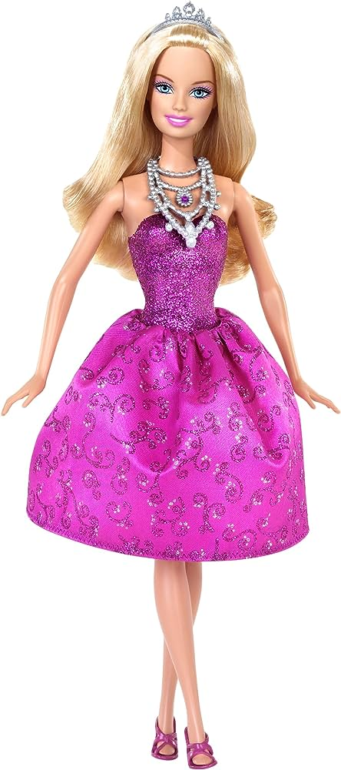
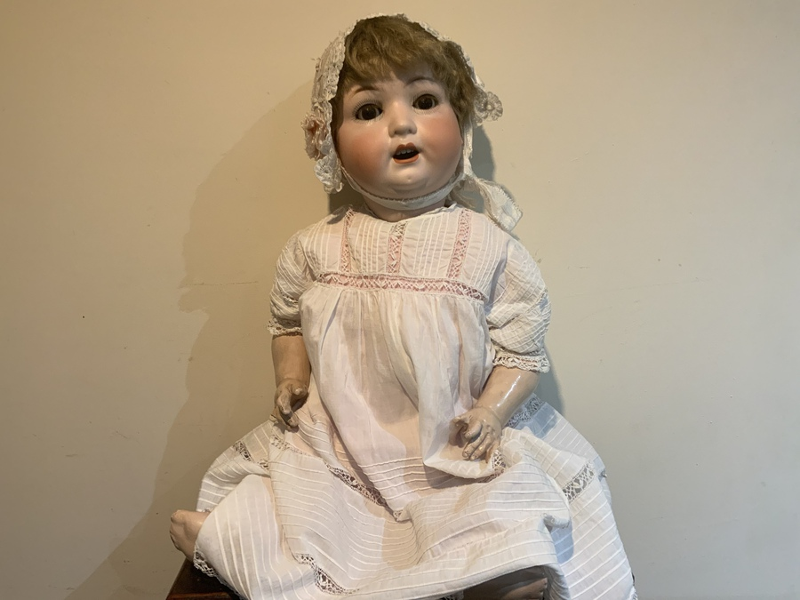
Year Group 1 and 2 Term 1 Topic: Toys from the Past and Puppets
Prior Vocabulary
1 | History | The study of what has happened in the past
2 | Past | What had already taken place
3 | Present | What is happening now
4 | Toddler | Young child
5 | Baby | Young child up to the age of one
6 | Future | Something that will happen
7
8
Prior Knowledge
Some children have leant about how houses have changed over time past living memory.
Some children can identify different types f houses from different time periods e.g. Tudor and Victorian houses.
Some children understand that materials have changed in house building.
All children can use time related vocabulary.
All children can talk about events in their own lifetime.
Future Learning – KS2 Outcomes
Changes in Britain from the Stone Age to the Iron Age, the Roman Empire and its impact on Britain; The Viking and Anglo-Saxon struggle for the Kingdom of England to the time of Edward the Confessor. A study of an aspect or theme in British history that extends pupils’ chronological knowledge beyond 1066
The achievements of the earliest civilizations – an overview of where and when the first civilizations appeared and a depth study of one of the following: Ancient Sumer; The Indus Valley; Ancient Egypt; The Shang Dynasty of Ancient China
Ancient Greece – a study of Greek life and achievements and their influence on the western world
A non-European society that provides contrasts with British history – one study chosen from: early Islamic civilization, including a study of Baghdad c. AD 900; Mayan civilization c. AD 900; Benin (West Africa) c. AD 900-1300.

