Slide 1


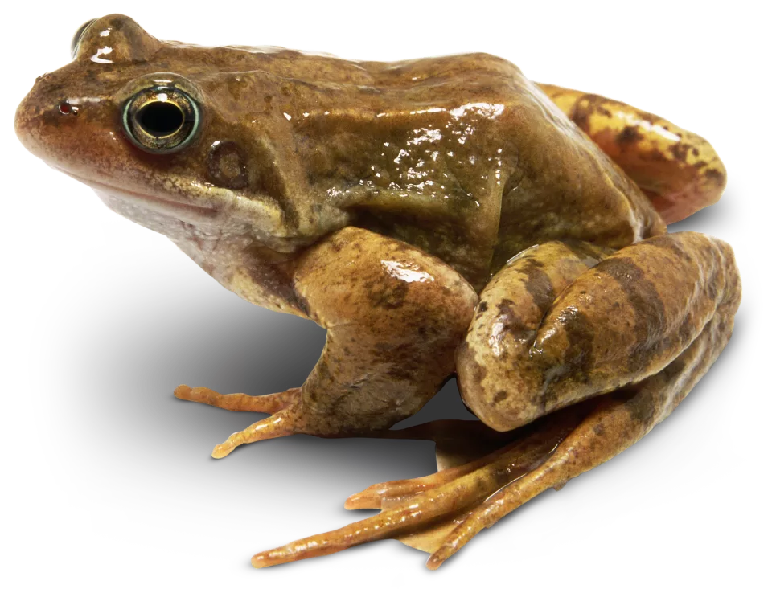
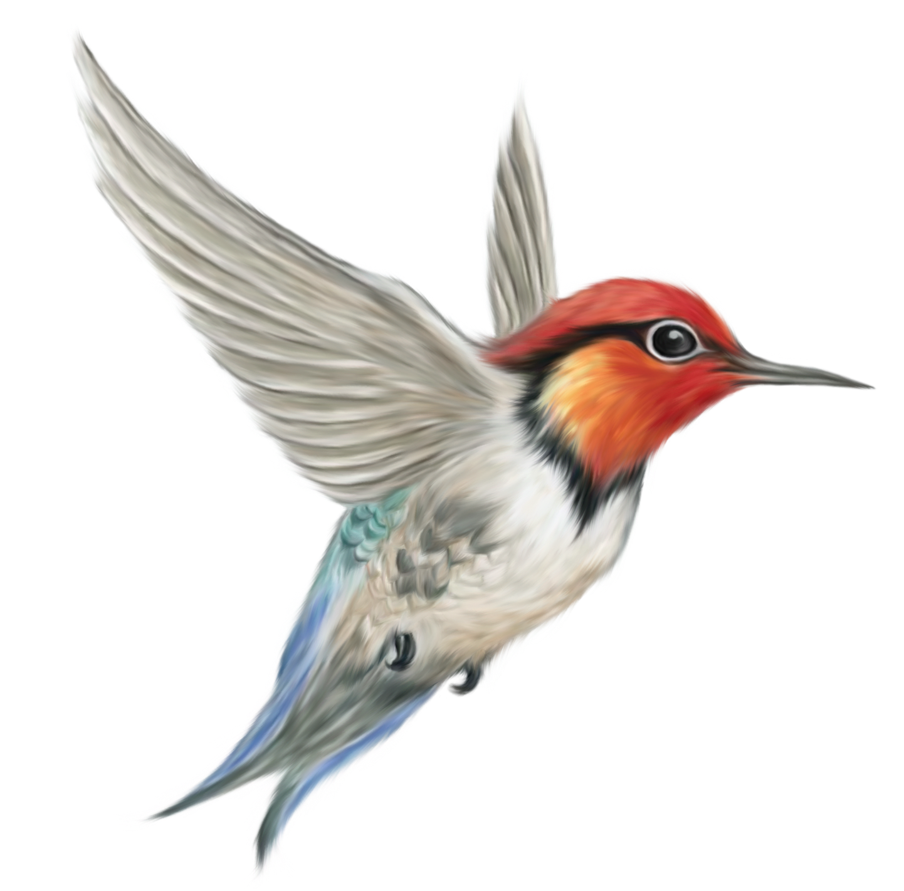
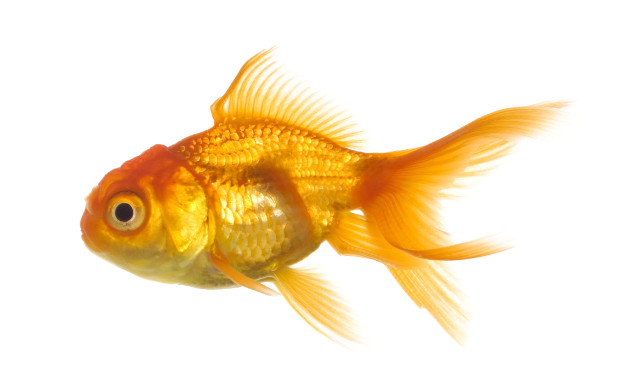
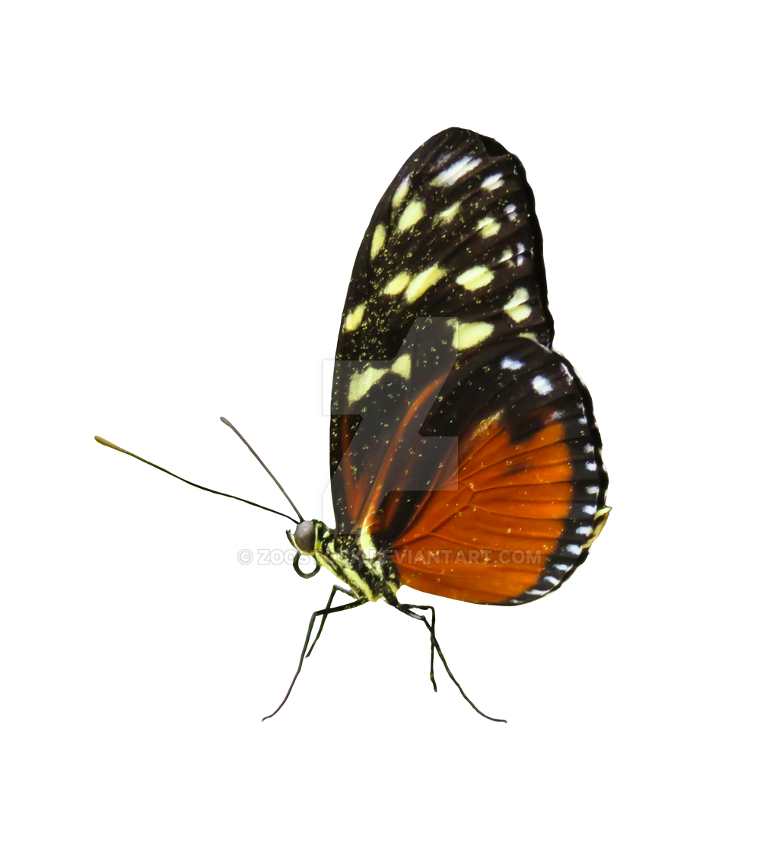

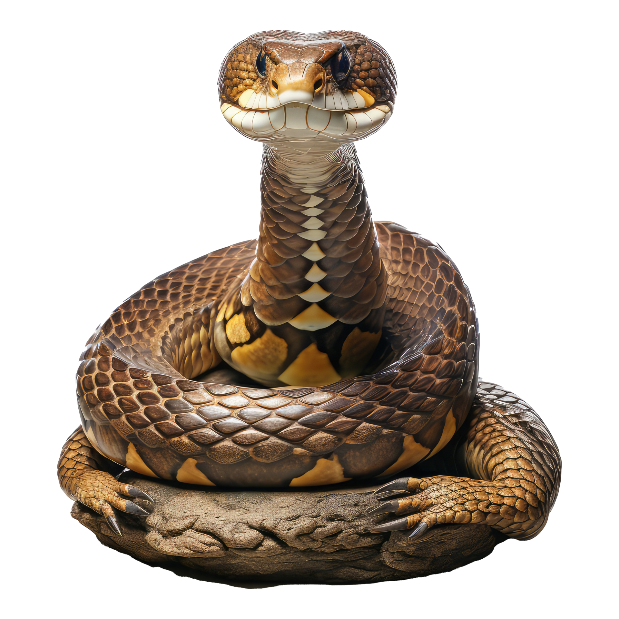
Science - Year Group: 1 / 2 Term: Spring Topic: Animals Including Humans
Key Vocabulary
Amphibian
Bird
Carnivore
Fish
Herbivore
Insect
Invertebrate
Mammal
Omnivore
Reptile
Vertebrate
Key Facts
Animals are living things.
Carnivores eat other animals (meat), herbivores eat plants and omnivores eat other animals and plants
Different animal groups have some common body parts, such as eyes and a mouth, and some different body parts, such as fins or wings.
Animals can be sorted and grouped into six main groups: fish, amphibians, reptiles, birds, mammals and invertebrates:
Amphibians are animals, such as a frog, that lives both on land and in water but must produce its eggs in water.
Birds are creatures with feathers and wings, usually able to fly.
Fish are animals that live in water, are covered with scales, and breathes by taking water in through its mouth.
Invertebrates are animals that do not have a spine.
Mammals are animals of which the female feeds her young on milk from her own body. Most mammals give birth to live young and do not lay eggs.
Reptiles are animals that produce eggs and use the heat of the sun to keep its blood warm.
Examples of Greater Depth Learning
How do different animal structures help animals, i.e. how do wings help animals fly?
Key Questions for the Topic
What are the features of different animals?
What makes something a living thing?
What do all living things need?
What do different animals eat?
Which body parts do different groups of animals have?
Spirituality
Window moments - Learning about the diversity of animals across the world encourages us to experience awe and wonder at the variety of life.
Mirror moments - Talking about animals in their local environment helps us feel connected to the world and our place within it.
Door moments - Learning about endangered animals makes us think about caring for creation and making thoughtful choices to protect life

Slide 2

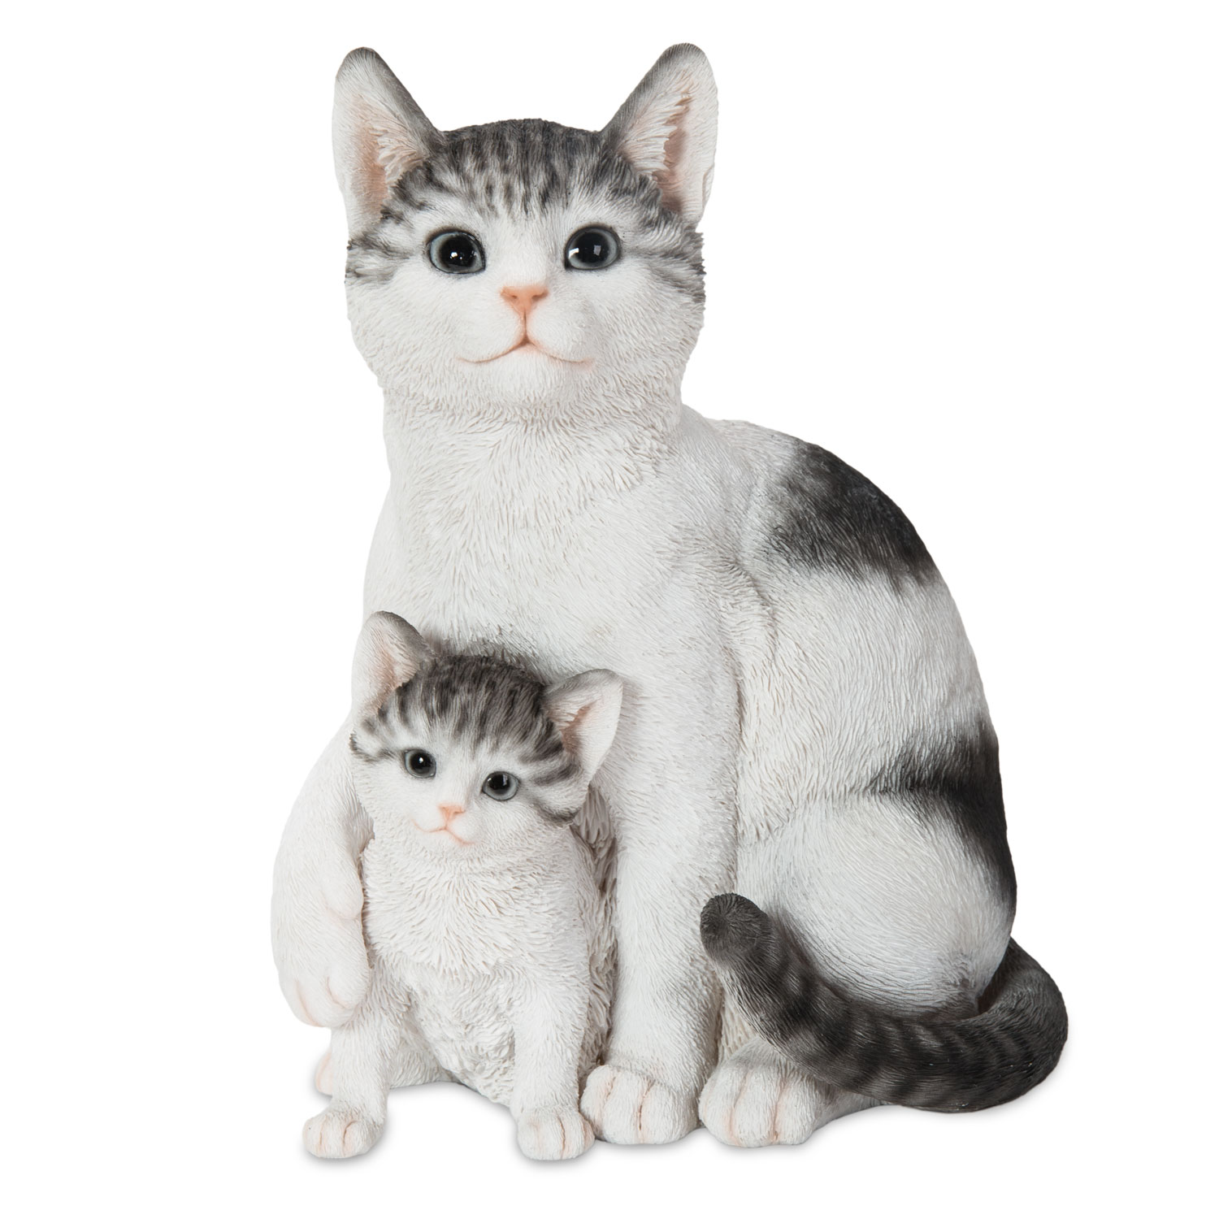
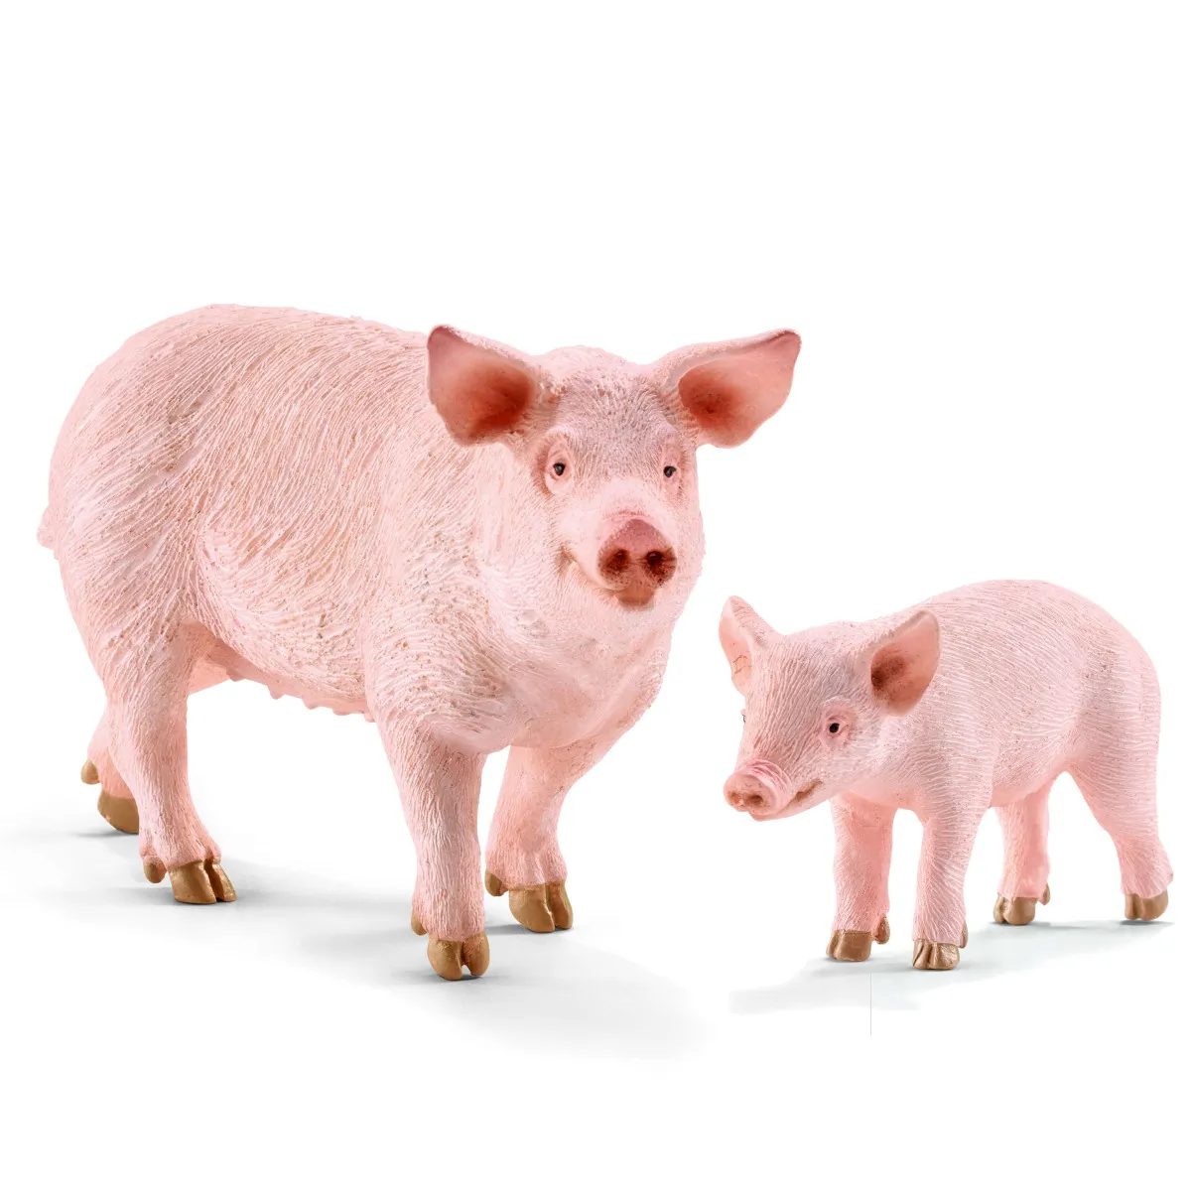
Science - Year Group: 1 / 2 Term: Spring Topic: Animals Including Humans
Prior Vocabulary
Habitat
Young
Character
Nocturnal
Predator
Camouflage
Life cycle
Prior Knowledge
Animals and humans are living things. Live young have different names Live young examples to be covered: Humans - babies, Whale - calf, Pig - piglet, Horse – foal , Elephant - calf, Common pet examples (dog - puppies, cat – kittens, rabbit – kit, guinea pig – pup).
Humans can eat plants and meat.
Animals need to eat different types of food to survive.
Some animals are awake at night and sleep during the day. These are nocturnal animals.
Human beings have a responsibility to care for the animals on the planet.
Future Learning
KS2 Identify that animals, including humans, need the right types and amount of nutrition, and that they cannot make their own food; they get nutrition from
Identify that humans and some other animals have skeletons and muscles for support, protection and movement what they eat.

