Slide 1
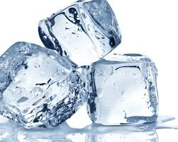
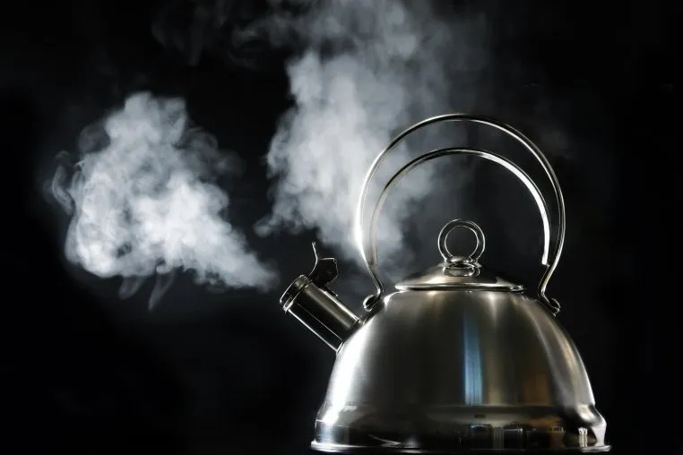
Science - Year Group: 1 / 2 Term: Spring Topic: Materials –Exploring Changes
Key Vocabulary
Materials | Substances or things that something is made from (e.g., wood, plastic, metal, fabric).
Change | To make something different from its original form
Solid | A state of matter where the material has a fixed shape and volume (e.g., ice, metal).
Liquid | A state of matter that has a fixed volume but no fixed shape, taking the shape of its container (e.g., water, milk).
Gas | A state of matter that has neither a fixed shape nor a fixed volume (e.g., air, steam).
Reversible | A change that can be undone, where the material returns to its original state.
Irreversible | A change that cannot be undone, where the material cannot return to its original form.
Sustainable | To make sure things we need are available in the future
Recyclable | Able to be used in some form
Sticky Knowledge
Some changes can be reversed and some are irreversible.
A material's physical properties make it suitable for particular purposes, such as glass for windows and brick for building walls.
Some objects float and others sink. Objects that float are typically light or hollow.
Some materials can be recycled so they are used for different purposes.
Many materials are used for more than one purpose, such as metal for cutlery and cars.
Materials can be solid (ice), liquid (water) or gas (steam).
Key Questions
How do different materials change?
Which changes are reversible?
What causes materials to change?
What are the different states of matter?
What materials are best for different jobs?

Slide 2
Science - Year Group: 1 / 2 Term: Spring Topic: Materials – Exploring Changes
Prior Vocabulary
Hard | Something tough or solid.
Soft | Something not hard.
Smooth | Something not bumpy.
Bumpy | Something with lots of bumps.
Wood | A material that comes from trees.
Metal | A material that is hard and shiny.
Plastic | A manmade material made from oil.
Material | What things are made of.
Heavy | Something that weighs a lot.
Light | Something that does not weigh a lot.
Rough | Something not smooth.
Shiny | Something that reflects light.
Recycle | Turning things we don’t need into other things.
Waterproof | Something that doesn’t let water get through.
Prior Knowledge
Materials have different textures. Some are soft and smooth. Others are hard and bumpy
Things can grow and change over time.
Models can be created using lots of different materials and tools. Some of these materials have had different uses. These materials are recycled.
Materials change when cooking. heating and cooling.
Things can grow, decay and change over time.
Some materials float or sink.
Future Learning
Year 3 forces - Compare and group together a variety of everyday materials on the basis of whether they are attracted to a magnet, and identify some magnetic materials.
Year 3 rocks - Recognise that soils are made from rocks and organic matter.

