Slide 1
Year Group 1 and 2 Term3 Spring Topic: The History of Space Travel and Moving Pictures
Key Vocabulary
Space | the area that contains the entire universe beyond the Earth.
Astronaut | A person who takes part in space flight.
Rocket | A flying device shaped like a tube.
Moon’s Surface | The surface of the moon.
Module | Parts of the spacecraft-command, service( which carried the fuel etc) and lunar which landed on the moon.
Command Module | The module where astronauts lived and worked
Orbit | the curved path in which a planet, satellite, or spacecraft moves in a circle around another body.
Space race | The competition in space exploration.
Lever | A mechanism where a picture turns around a pivot.
Wheel | A mechanism where a picture turns around an axis.
Slider | A mechanism where a picture slides.
Sticky Knowledge
The first rocket was called the V2.
The first time a human set foot on the moon was on 20th July 1969.
The first astronauts that landed on the Moon were Neil Amstrong, Edwin Aldrin and Michael Collins.
The different inventions of flight are hot air balloons, airships, aeroplanes, helicopters and rockets.
The space race was between Russia and USA to reach the moon.
There are different sources of evidence for the moon landing.
Mechanisms can be used to create moving parts in books.
There are many different types of mechanisms i.e., levers, sliders, pivots and wheels.
Examples of Greater Depth Knowledge
Children can explore and investigate different sources of evidence and can explain what it teaches them about the moon landing.
There were different types of living things that were sent into space e.g. fruit flies, monkey, dog before humans.
Russia was leading the space race at the beginning.
There were other very important people who contributed to the success of the Apollo 11 landing.
Key Questions
Has man ever been to the Moon and how can we know for sure?
Why did the astronauts risk their lives going to the moon?
How were the astronauts able to get to the Moon and back safely?
What did the astronauts do on the Moon?
Does everyone have the same opinion on space travel?
Is the Moon Landing a significant event in the history of space exploration?
What type of moving mechanisms are there in picture books?
Can I create a variety of different moving mechanisms i.e. sliders, levers, wheels?
Can I plan and make moving mechanisms for a page in a picture book?
Spirituality
Window Moments Investigate and appreciate the beauty, dangers and adventures of what it might be like to explore space.
Mirror Moments Ponder about what an amazing achievement it was to send those astronauts into space, land on the moon and safely get them to return!
Door Moments How can I show courage in my day-today life and be ambitious for myself?

Slide 2
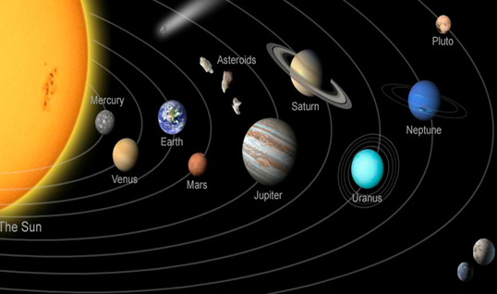
Year Group 1 and 2 Term Spring Topic: The History of Space Travel
Prior Vocabulary
1 | Planet | A planet is a large object that orbits a star. It is smaller than a star, and it does not make light.
2 | Solar system | It includes our Sun, its eight planets and their moons, and all other bodies that travel around the Sun.
3 | Earth | The planet we live on.
4 | Space | The area that contains the entire universe beyond the earth; outer space.
5 | Sun | The star in the middle of our solar system.
6 | Moon | a satellite that revolves around the Earth.
7 | Star | a heavenly body that gives out lots of light and heat.
8 | Crater | a hollow area shaped like a bowl.
Prior Knowledge
Understanding the World
There are 8 planets in our solar system.
We live on planet called Earth. It is the third planet from the Sun.
The solar system consists of the Sun and everything that orbits, or travels around, the Sun. This includes the eight planets and their moons, dwarf planets, and countless asteroids, comets, and other small, icy objects.
Space is the area that contains the entire universe beyond the Earth.
The Sun is not a planet but a star. All the planets in our solar system orbit (move around) the Sun. The sun provides heat and light to the planets.
The Moon orbits Earth. The Moon has craters on it, caused by rocks crashing onto the surface.
Astronauts are people who have travelled to space and in 1969, some astronauts landed on the Moon. Astronauts need to wear space suits when they travel into space.

