Slide 1
Science - Year Group: 1 / 2 Term: Summer Topic: Plants
Key Vocabulary
germinate | When a seed starts to sprout and grow
seedling | A very young plant that has just started to grow
seed coat | The tough outer layer that protects a seed
embryo | The tiny baby plant inside a seed
food store | The energy-rich food packed inside a seed to help it grow
nutrient | A substance in soil that helps plants grow
disperse | To spread or scatter seeds away from the parent plant
pollinate | To move pollen from one flower to another
condition | The environment a plant needs to grow well
lifecycle | The stages a plant goes through from seed to seed
pesticide | A chemical used to kill insects or other animals that damage plants
predator | An animal that hunts and eats other living things
environment | The natural world around us — air, water, soil and living things
Sticky Knowledge
Plants need water, light and a suitable temperature to grow and stay healthy.
Seeds and bulbs grow into mature plants.
As the plant grows bigger, it develops leaves, stems and flowers.
Plants grow at different speeds depending on their needs.
Seeds can be dispersed by wind, water, animals and by explosion.
Many predators eat plants, pesticides are used to protect plants. Some pesticides are harmful to the environment.
Many animals (predators) eat plants. Pesticides are chemicals used to protect plants — but some can harm the environment.
Plants make their own food through their leaves using sunlight (photosynthesis).
Greater Depth Knowledge
Seeds have everything inside them that they need to grow.
Without the right conditions (light, water, warmth, air) a seed will not germinate.
Leaves are essential — they capture sunlight to make food for the plant.
Some pesticides kill helpful insects (like bees) as well as harmful ones — this harms plants and the environment.
Key Questions
Do plants all need the same things to grow?
Which plants cannot be eaten?
What do plants need to grow and stay healthy?
What are the different ways that seeds are spread?
What happens inside a seed when it is germinated?
How do living things depend on plants?
Why might pesticides be harmful to the environment?
How can we protect plants without harming other living things?
Spiritual Moments – wonder and reflection
I wonder … How a tiny seed contains everything it needs to become a huge plant? Why plants grow towards the light. What might that teach us?
Time to reflect …. Think of something in your own life that started very small but grew into something important. How do YOU need to be cared for to grow well — just like a plant needs water and light?
Awe and appreciation… Take a moment to look closely at a seed or plant. What amazes you most about it?

Slide 2
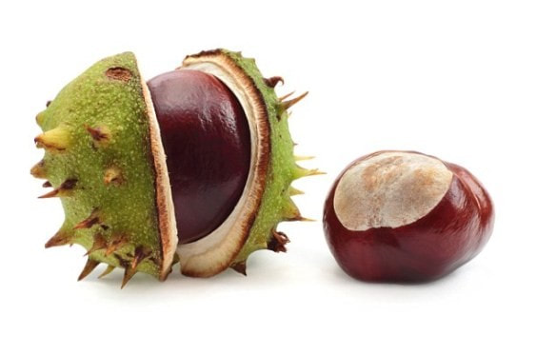
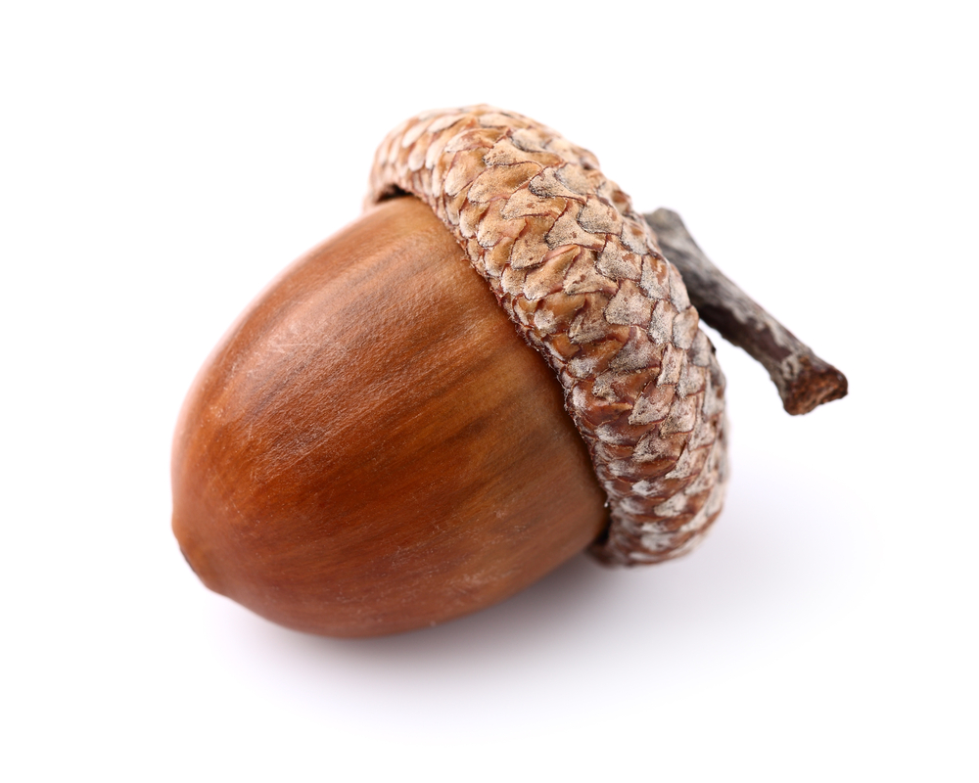
Science - Year Group: 1 / 2 Term: Summer Topic: Plants
Prior Vocabulary
plant | Living things that grow from soil.
leaves | These are usually flat and green and grow from the stem.
seed | A small part of a flower that grows into a new plant
flower | The part of a plant that has petals.
petal | The soft brightly-coloured part of a flower
stem | The stem of a plant holds it upright.
Trunk | Thick woody stem of a tree.
Soil | A mixture of materials that cover the Earth’s surface.
habitat | A place where things live and grow.
root | A root. is a part of a plant that is usually hidden underground. They hold the plant in the ground and take water from the soil.
Acorn | The nut of an oak tree.
Conker | The nut of a horse chestnut tree.
Weed | A plant that grows where it is not wanted.
Prior Knowledge
Leaves are different shapes which helps them survive.
Plants need to be cared for to ensure they survive.
Plants are living things that change as they grow and mature.
Plants need water to survive.
Some plants can be eaten and some are dangerous for us.
Future Learning
Year 3
Identify and describe the functions of different parts of flowering plants: roots, stem/trunk, leaves and flowers Explore the requirements of plants for life and growth (air, light, water, nutrients from soil, and room to grow) and how they vary from plant to plant Investigate the way in which water is transported within plants Explore the part that flowers play in the life cycle of flowering plants, including pollination, seed formation and seed dispersal.
conker
acorn

