Slide 1


Year Group 1 and 2 Term Autumn Science- Habitats
Key Vocabulary
Life processes | All the things that living things do.
Living | Things that are living have all the life processes.
Dead | Things that are dead were once living. They did have all the life processes , but they are not now.
Never living | Things made out of metal, rock and plastic were never living. They never had the life processes.
Habitat | It is the natural place where something lives. It provides living things with everything they need to survive such as food, shelter and water.
Microhabitat | It is a very small habitat in places like under a rock or under leaves.
Survive | It means to stay alive.
Woodland | An area of land covered with lots of trees, plants and wildlife.
Urban | An area where lots of people live and work, with buildings, roads and shops.
Endangered | When a type of animal or plant is in danger of becoming extinct because there are very few left.
Sticky Knowledge
I can give examples of living things, dead things and things that were never alive.
I can name some of the seven life processes.
I can give examples of British habitats e.g. forest, urban, coastal, sea etc.
I can say what type of habitat I live in and give some examples of how humans can change their habitats.
I can draw a map of a local habitat and label the trees and plants.
I can find examples of microhabitats in the playground.
I can design a bug hotel for a chosen minibeast and understand what the minibeast needs to survive in the microhabitat.
Examples of Greater Depth Knowledge
I can explain how a habitat changes over time, including how the seasons, weather and human activities can affect the plants and animals living there.
I can explain how we can protect habitats and support sustainability, suggesting ways to reduce human impact and help wildlife survive, such as creating bug hotels, planting native flowers and protecting natural spaces.
Key Questions | Opportunities for Spirituality
What are the different types of British habitats and what different animals / plants lives there? | Explore the incredible variety of living things in different habitats, developing a sense of wonder at the complexity and beauty of the natural world.
Can I find examples of living, dead and never living things in my local habitat? Can I draw a map of the local habitat? | Reflect on how all living things are connected and depend on one another. Consider our place within the natural world and our responsibility to care for it.
Can I find out what minibeasts live in a microhabitat? | Observe a local habitat, noticing the small details often overlooked, such as insects, plants and signs of wildlife.
Can I design a bug hotel for my chosen minibeast? What conditions does my minibeast need? | Consider how our actions can make a difference to the environment. Reflect on how we can protect habitats.

Slide 2

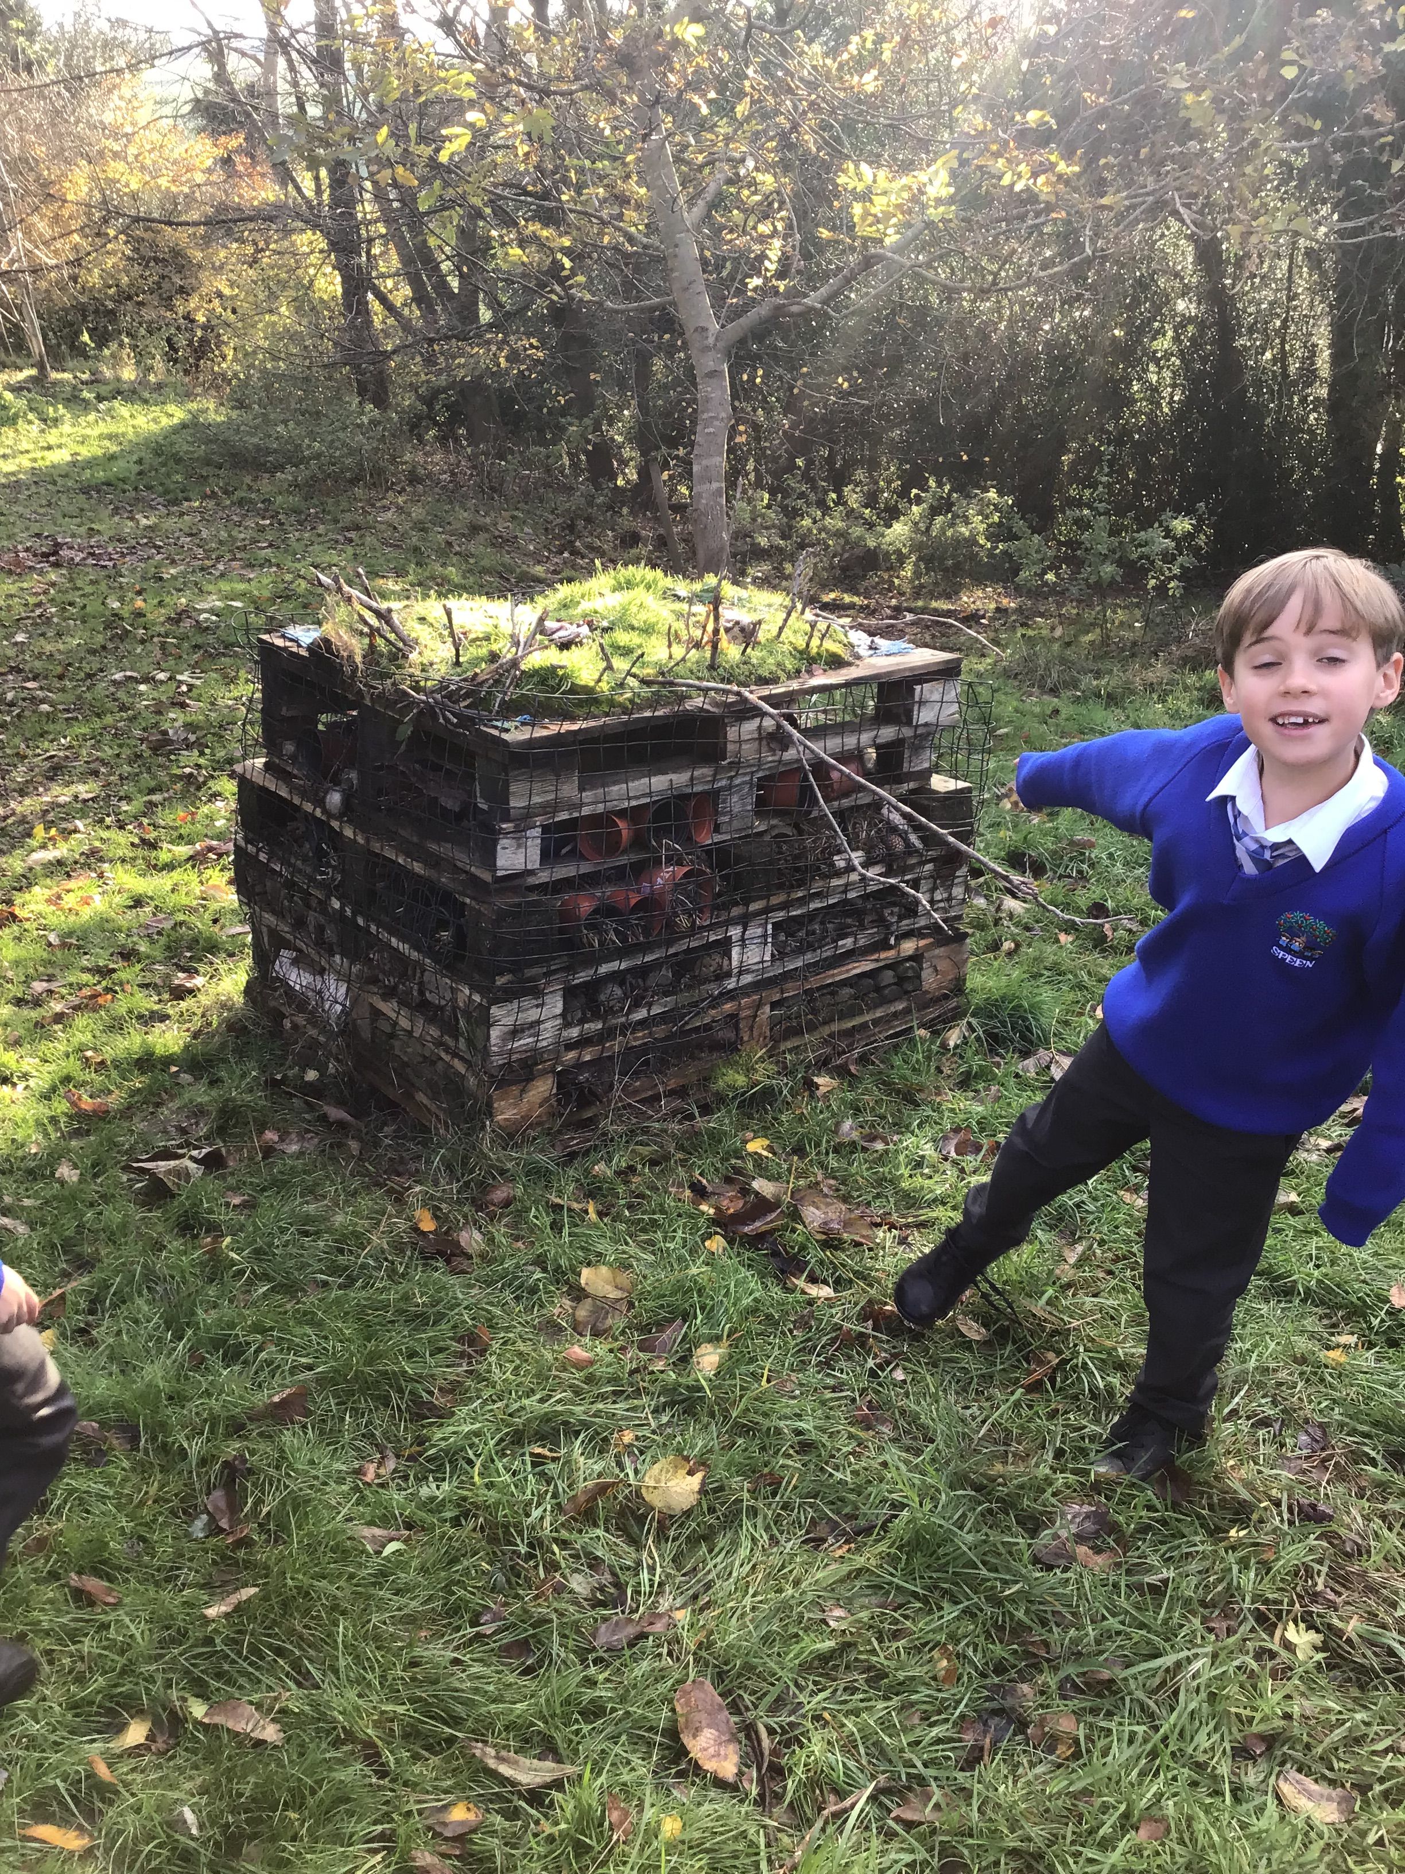
Year Group 1 and 2 Term Autumn Science - Habitats
Prior Vocabulary
Different | Not the same, not alike
Similar | Having a likeness to something else
Life cycle | Changes living things go through
Nutrition | Food needed to live
Carnivore | An animal that eats meat
Herbivore | An animal that eats plants
Omnivore | An animal that eats meat and plants
minibeasts | Different types of insects
forest | Large wooded area
Prior Knowledge
Understanding the World
Explored and seen different habitats in and near school grounds
Found examples of living things and things that have not been alive in forest school lessons.
Say some of the life processes that tell us we are alive in relation to human beings e.g. we breathe, we move, we eat
Know that different animals live in different environments
Future Learning – KS2 Outcomes
Living things need food to grow and to be strong and healthy
Plants can make their own food, but animals cannot.
To stay healthy, humans need to exercise, eat a healthy diet and be hygienic
Animals, including humans, need food, water and air to stay alive

