Slide 1

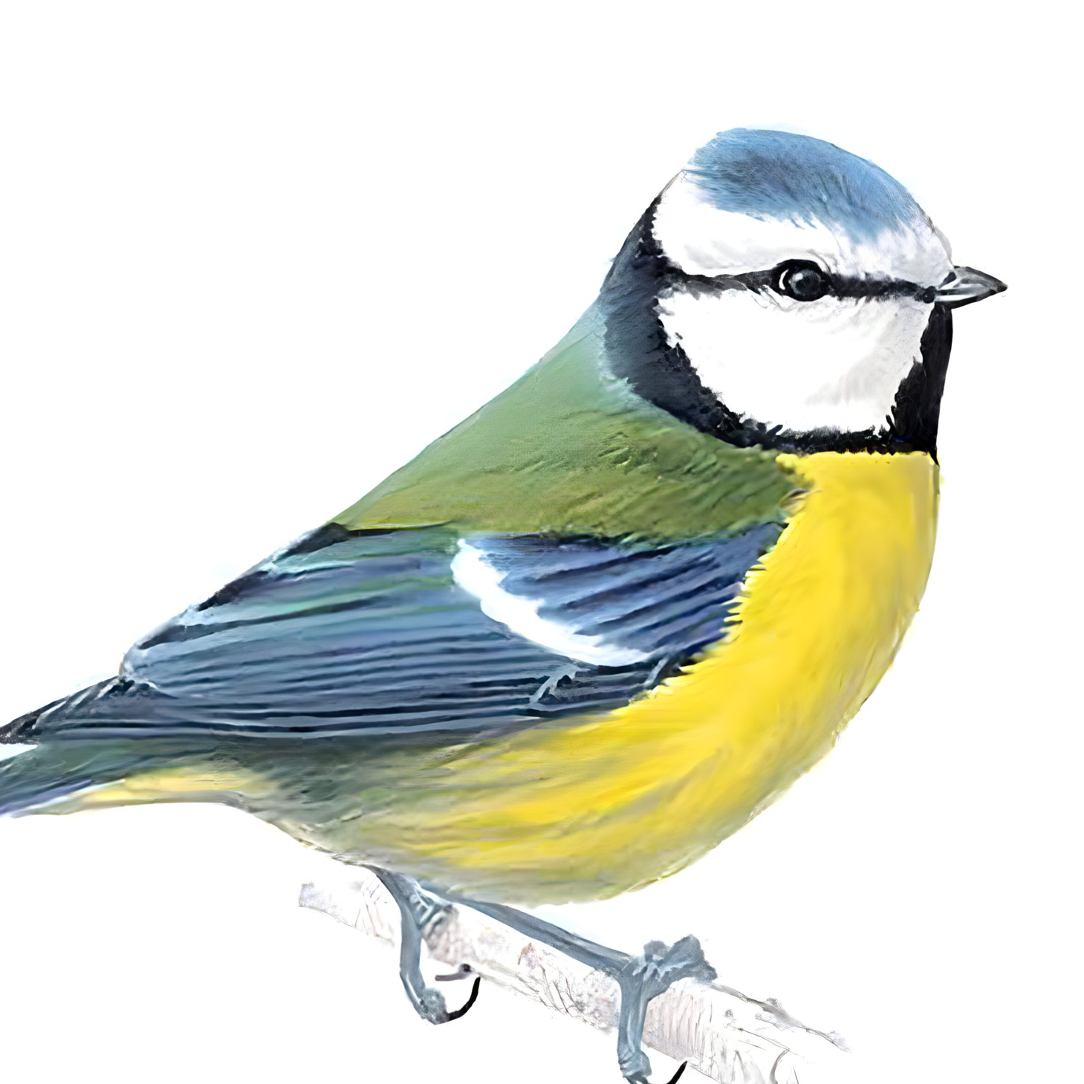

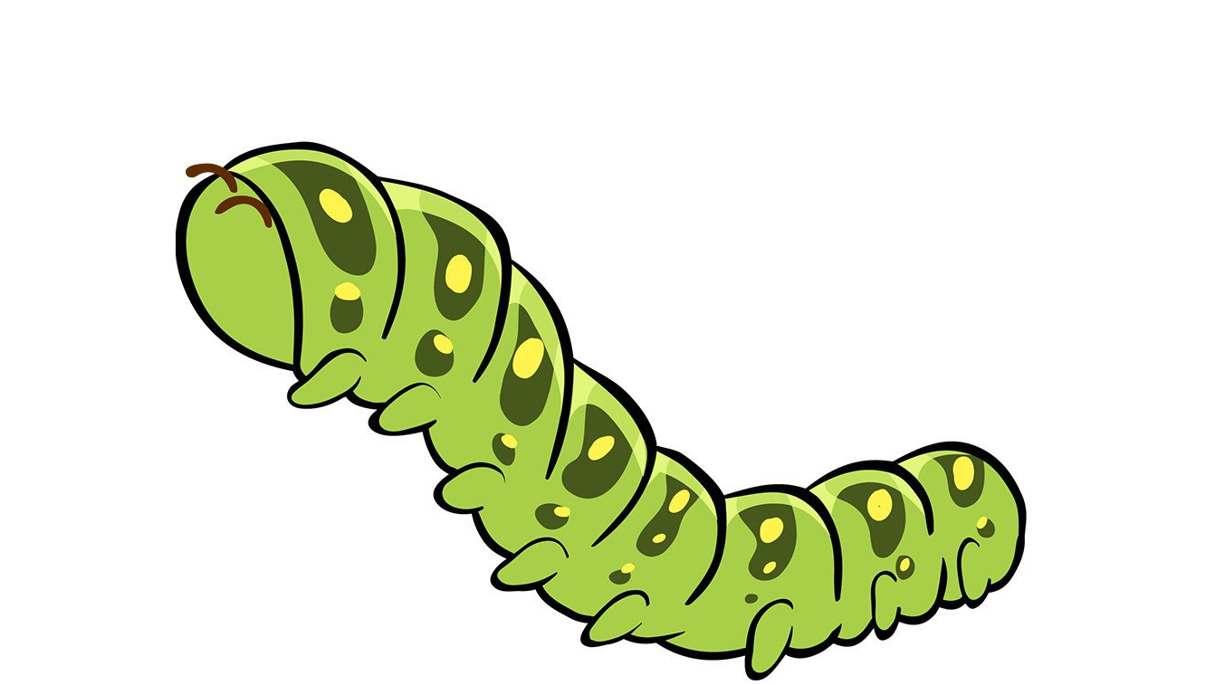
Science - Year Group: 1 / 2 Term: Summer Topic: Food Chains
Key Vocabulary
Living | Things that can grow, move, breathe and reproduce.
Non-living | Things that can not grow, move, breathe and reproduce.
Dead | Something that is no longer alive.
Consumer | All animals are consumers as they eat plants and other animals
Producer | Green plants because they make their own food.
Predator | Animals that eat other animals.
Prey | Animals that are eaten by predators.
Habitat | A habitat is the natural place something lives. A habitat provides living things with everything they need to survive such as food, shelter and water.
Microhabitat | A small habitat.
Food Chain | A food chain shows how each animal gets its food.
Food Source | This is the place a living thing’s food comes from.
Energy | Something that can do work.
Sticky Knowledge
Each food chain starts with a green plant. Green plants are called producers because they produce their own food.
All animals are called consumers because they consume their food by eating plants and other animals.
Animals that eat other animals are called predators. The animals that they eat are called prey.
Some animals can be both a predator and prey.
Living things in habitats rely on each other.
Food chains are one of the ways that living things depend on each other to stay alive
Food chains have an apex predator at the top. This is the top animal that nothing else eats.
Example of Greater Depth Knowledge
Explain why disrupting one part of a food chain affects the whole chain. Construct food chains using correct vocabulary and identify the apex predator, explaining why nothing eats it. Compare food chains from different habitats and recognise that energy always flows from the sun through producers to consumers.
Key Questions | Opportunities for Spirituality
Can you decide whether something is living, dead or non-living? | Reflect on what makes something alive. Wonder at the miracle of life and the wide variety of living things God has created.
Can you describe some of the life processes common to plants and animals, including humans? | Consider how all living things share basic needs. Be amazed at the diversity and complexity of life on Earth.
Can you explain how living things in a habitat depend on each other to survive? | Think about how every creature in a habitat depends on others. Appreciate how fragile and interconnected the natural world is.
Can you explain the transfer of energy from the sun to all living things? | Marvel at the sun as the source of all energy on Earth. Feel a sense of awe that sunlight supports every living thing through food chains.

Slide 2
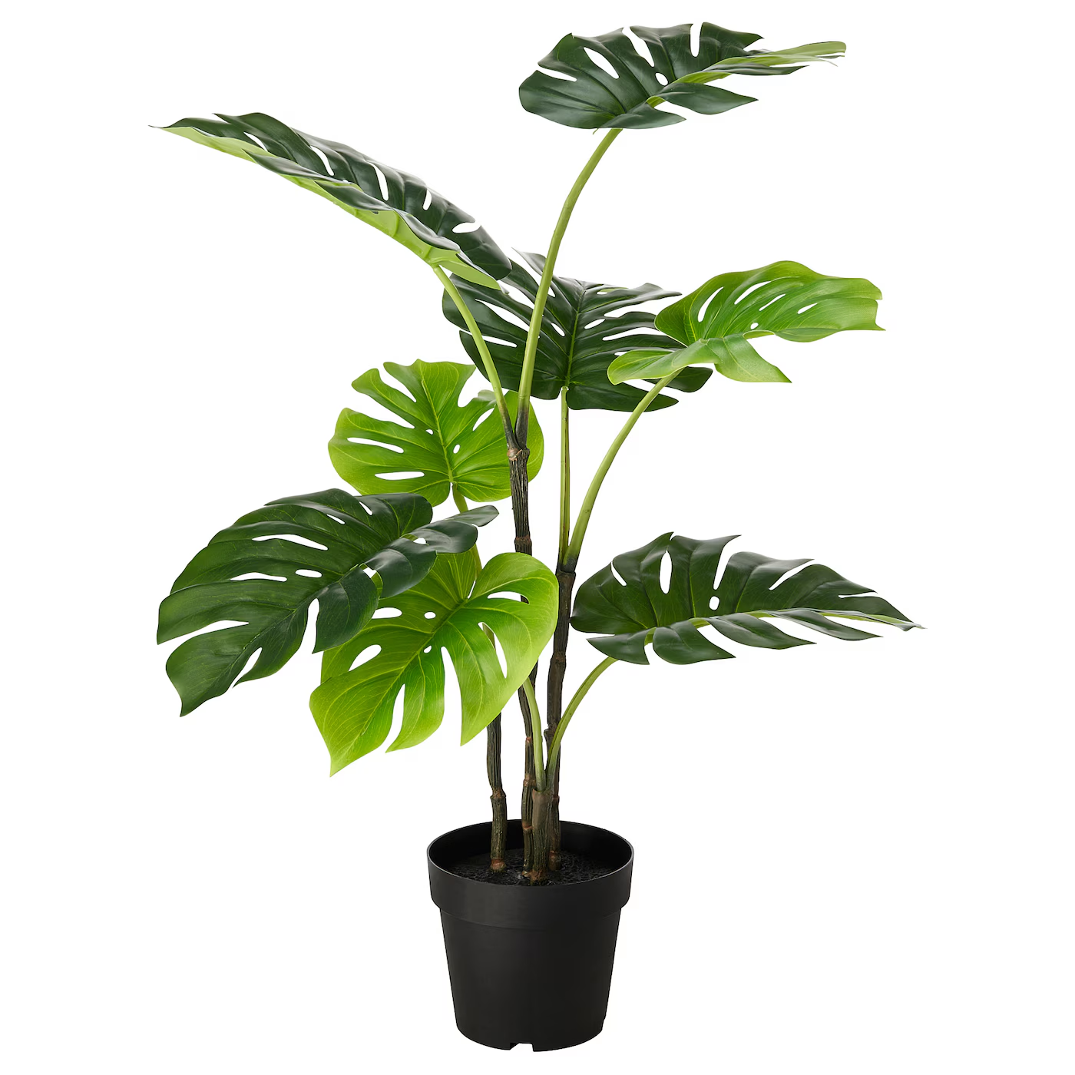
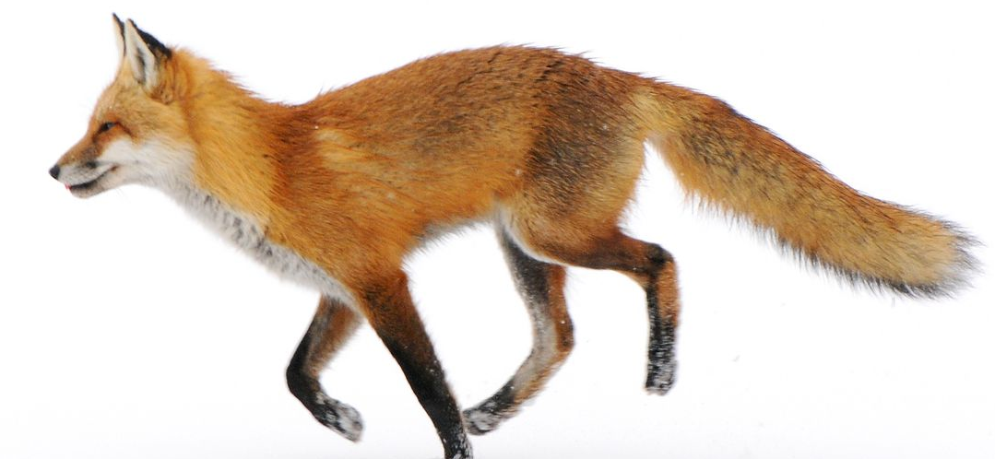
Science - Year Group: 1 / 2 Term: Summer Topic: Food Chains
Prior Vocabulary
Minibeasts | Small creatures like snails, slugs or spiders.
Herbivores | Animals that eat plants only.
Carnivores | Animals that eat meat only.
Omnivores | Animals that eat plants and meat.
Plant | One of a large group of living things that use sunlight to make their own food.
Animal | One of a large group of living things that can move around by themselves to find food.
Prior Knowledge
Animals can live in homes as pets and also in the wild.
Animal’s homes have different names. Pigs live in a sty, horses in a stable, rabbits in a burrow, foxes in a den.
The local environment is a habitat for living things and can change during the seasons
Living things need to be cared for in order for them to survive. They need water, food, warmth and shelter.
The wild animals around Speen have many different types of homes.
Animals need to eat many different types of food to survive.
Future Learning
Year 3
Identify that animals, including humans, need the right types and amount of nutrition, and that they cannot make their own food; they get nutrition from what they eat.
Year 1 / 2 – Cycle B Animal homes and habitats
Plant
Animal

